Slide 1


Database Technologies - MySQL
A day without new knowledge is a lost day.
the quality of having experience, knowledge, and good judgement; the quality of being wise.
The DIKW pyramid
skills acquired through experience or education, the theoretical or practical understanding of a subject.
learned about something or someone.
infoway
https://hackr.io/blog/dbms-normalization#First_Normal_Form_1NF

Slide 2
Index
Topic
How would you explain a database in three sentences to a child?
What is Relation and Relationship?
What is a database management system?
What is a relational database management system?
What is database?
What is data?
DBMS and RDBMS
What is Entity Relationship Diagram?
What is Entity?
What is Entity Type?
What is an Attribute?
What is an Prime, Non-Prime Attribute?

Slide 3
Index
Topic
Entity Relationship Diagram Symbols.
Common relationships
What is Data Modeling?
What is Schema?
SQL Structured Query Language
Login to MySQL
SHOW DATABASES
Information Functions
Source Command
Show Columns
Show Tables
Show Tables Status

Slide 4
Index
Topic
Explain
SELECT statement…
Column - ALIAS
Column - EXPRESSIONS
Identifier Qualifiers
Control Flow Functions
Date and Time Functions
Date and Time Formats
String Functions
Mathematical Functions
SELECT statement… syntax
ORDER BY Clause

Slide 5
Index
Topic
WHERE Clause
SELECT … expressions
GROUP BY Clause
HAVING Clause
Row Limiting Clause
User-Defined Variables
Rownum
Prepared SQL Statement
SELECT ... INTO
SELECT ... INTO var_list
SELECT ... INTO OUTFILE
SELECT ... INTO DUMPFILE

Slide 6
Index
Topic
Sub-Queries
JOINS
USING and ON clause
Set Operation in SQL
CREATE TABLE ... LIKE STATEMENT
CREATE TEMPORARY TABLE ... LIKE STATEMENT
CREATE TABLE ... SELECT STATEMENT
Commit and Rollback
INSERT ROWS using VALUES
INSERT ROWS using SET
INSERT ROWS using SELECT
REPLACE using VALUES

Slide 7
Index
Topic
REPLACE using SET
REPLACE using SELECT
Single-table UPDATE
Multiple-table UPDATE
Single-Table DELETE
Multiple-table DELETE
Datatypes
JSON Datatype
CREATE TABLE
CONSTRAINTS
INFORMATION_SCHEMA

Slide 8
Index
Topic

Slide 9
Class Room
Session 1

Slide 10
How would you explain a database to a child?

Slide 11

Explain a database in three sentences.
You know, how you have to put your toys away after playing, so you can find them easily the next time you want to play with them?
A database is like a shelf to put your toys away, assume the toys are data instead.
Now, the database can always find the right data easily - whether it's "all the outdated toys" or "all the yellow toys," the computer can get / fetch everything very quickly, as it is stored in database.

Slide 12

MySQL
MySQL is the most popular Open Source
Relational Database Management System.
MySQL was created by a Swedish company - MySQL AB that was founded in 1995. It was acquired by Sun Microsystems in 2008; Sun was in turn acquired by Oracle Corporation in 2010.
When you use MySQL, you’re actually using at least two programmes. One program is the MySQL server, mysqld and other program is client program that connects to the database server.

Slide 13
What is Relation and Relationship?

Slide 14
What is Relation and Relationship?
Relation ("R"): In Database, a relation represents a table or an entity than contain attributes.
Relationship: In database, relationship is that how the two entities are connected to each other, i.e. what kind of relationship type they hold between them.
Primary/Foreign key is used to specify this relationship.

Slide 15

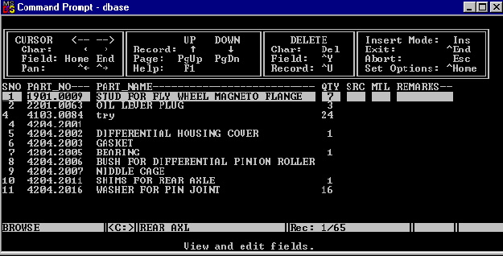

What is a database management system?

Slide 16
What is a database management system?
A database management system (DBMS) is software for creating and managing databases. The DBMS provides users and programmers with a systematic way to create, read, update, and delete data.
DBMS
It supports Single User only
Not Secured
No Relationship (PK/FK)

Slide 17

What is a relational database management system?

Slide 18



relational database management system?
A relational database management system (RDBMS) is a database management system (DBMS) that is based on the relational model.
RDBMS supports
client/server Technology
Highly Secured
Relationship (PK/FK)

Slide 19
properties of relational table
ID | firstName
1 | Saleel Bagde
2 | Sharmin
3 | Vrushali
4 | Ruhan
Relational tables have six properties:
Values are atomic.
Column values are of the same kind.
Each row is unique.
The sequence of columns is insignificant – (unimportant).
The sequence of rows is insignificant – (unimportant).
Each column must have a unique name.

Slide 20
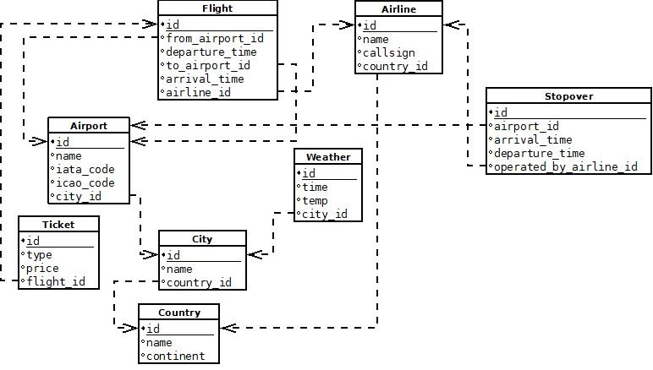

Slide 21

A database application is a computer program whose primary purpose is entering and retrieving information.
What is database?

Slide 22

What is Database?
A database is a system to organize, store and retrieve large amounts of data easily, which is stored in one or more data files by one or more users.
Each database is a collection of tables, which are called relations, hence the name "relational database".
Index Page

Slide 23

What is data?

Slide 24

What is Data?
Data is any facts, number, text, symbol, images, audio, video, or signal that can be recorded and that can be processed by a computer.
Data can be in the form of Text or Multimedia

Slide 25
DBMS and RDBMS

Slide 26
Difference between DBMS and RDBMS?
DBMS | RDBMS
DBMS applications store data as file. | RDBMS applications store data in a tabular form.
Normalization is not present in DBMS. | Normalization is present in RDBMS.
DBMS does not apply any security with regards to data manipulation. | RDBMS defines the integrity constraint for the purpose of ACID (Atomocity, Consistency, Isolation and Durability) property.
DBMS uses file system to store data, so there will be no relation between the tables. | in RDBMS, data are stored in the form of tables, so a relationship between these data will be stored.
DBMS does not support distributed database. | RDBMS supports distributed database.
Examples of DBMS are file systems, xml etc. | Example of RDBMS are mysql, postgre, sql server, oracle etc.

Slide 27
ACID properties of transactions
Atomicity. In a transaction involving two or more separate pieces of information, either all of the pieces are committed or none are.
Consistency. A transaction either creates a new and valid state of data, or, if any failure occurs, returns all data to its state before the transaction was started.
Isolation. A transaction in process and not yet committed must remain isolated from any other transaction.
Durability. Committed data is saved by the system such that, even in the event of a failure and system restart, the data is available in its correct state.

Slide 28
What is Entity Relationship Diagram?

Slide 29
Entity Relationship Diagram (ER Diagram)
Use E-R model to get a high-level graphical view to describe the "ENTITIES" and their "RELATIONSHIP"

Slide 30
Entity Relationship Diagram (ER Diagram)
The basic constructs of ER Model are
Entity, Attributes and Relationships.

Slide 31
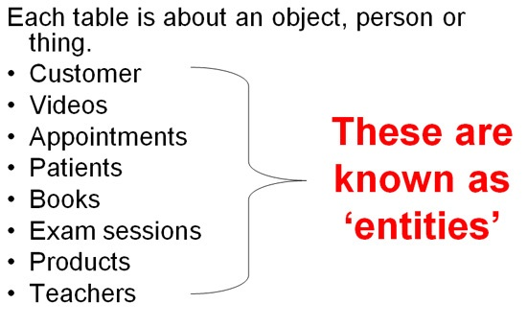
An entity can be a real-world object.
What is Entity?

Slide 32
Entity
In relation to a database , an entity is a person, place, or thing about which data can be stored.
e.g., in a school database, students, teachers, classes, and courses can be considered as entities.
All these entities have some attributes or properties that give them their identity.
Every entity has its own characteristics.

Slide 33
What is Entity Type?

Slide 34
Entity type
The entities that have the common attributes is called an entity type.
Each entity type in the database is described by a name and a list of attributes.
e.g. an entity Person is an entity type that has Age, Name and Address attributes.
Eg.
Entity TYPE Entity
Person (Age, Name, Address ,. . .) 17 , Sharmin, Paud Road, …

Slide 35
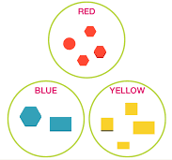
When you are designing attributes for your entities, you will sometimes find that an attribute does not have a value for every instance of the entity. For example, you might want an attribute for a person's middle name, but you can't require a value because some people have no middle name. For these occasions, you can define the attribute so that it can contain null values.
What is an Attribute?
Entity
In some cases, you might not want a specific attribute to contain a null value, but you don't want to require that the user or program always provide a value. In this case, a default value might be appropriate. A default value is a value that applies to an attribute if no other valid value is available.
Attribute

Slide 36
Attributes
A table has rows and columns
In RDBMS, a table organizes data in rows and columns. The COLUMNS are known as ATTRIBUTES / FIELDS whereas the ROWS are known as RECORDS / TUPLE.
In Relation: EMP
Attributes
SSN | EmployeeName | Job | Hiredate | Salary
1 | KING | PRESIDENT | 2017-02-15 | 5000
… | … | … | … | …
… | … | … | … | …
… | … | … | … | …
Rows

Slide 37
Attributes
In Entity Relationship(ER) Model attributes can be classified into the following types.
Simple/Atomic and Composite Attribute
Single Valued and Multi Valued attribute
Stored and Derived Attributes
Complex Attribute

Slide 38
Attributes
Simple / Atomic Attribute --VS-- Composite Attribute
(Can’t be divided further) (Can be divided further)
Single Value Attribute --VS-- Multi Valued Attribute
(Only One value) (Multiple values)
Stored Attribute --VS-- Derived Attribute
(Only One value) (Virtual)
Complex Attribute
(Composite & Multivalued)

Slide 39
Composite VS Multi Valued Attribute

Slide 40

Composite / Multi Valued Attributes
Composite Attribute
Person Entity
Name attribute: FirstName, MiddleName, and LastName
PhoneNumber attribute: CountryCode, CityCode, and PhoneNumber
Multi Valued Attribute
Person Entity
Hobbies attribute: reading, hiking, hockey, skiing, photography.
SpokenLanguages attribute: Hindi, Marathi, Gujarati, English.

Slide 41
What is an Prime, Non-Prime Attribute?

Slide 42
Attributes
Prime attribute
An attribute, which is a part of the prime-key, is known as a prime attribute.
Non-prime attribute
An attribute, which is not a part of the prime-key, is said to be a non-prime attribute.

Slide 43
Entity Relationship Diagram Symbols

Slide 44
Entity Relationship Diagram Symbols
Attribute
Composite Attribute
Key Attribute
Strong Entity
Weak Entity
Derived Attribute
Weak Relationship
Relationship
Multivalued Attribute

Slide 45
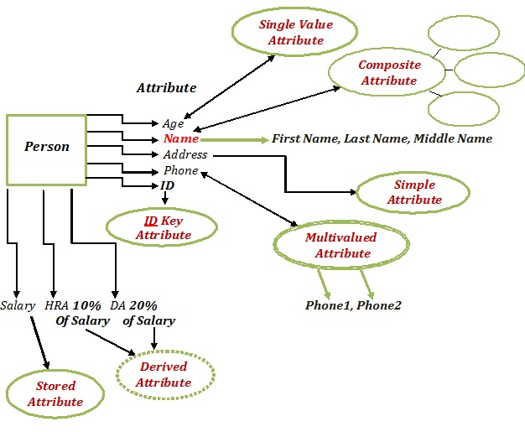
Entity Relationship Diagram

Slide 46
What is a degree, cardinality, domain, and union in database?
Degree d(R): Total no of attributes/columns present in a relation/table is called degree of the relation and is denoted by d(R).
Cardinality |R|: Total no if tuples present in a relation or Rows present in a table, is called cardinality of a relation and is denoted by |R|.
Domain: Total range of accepted values for an attribute of the relation is called the domain of the attribute. (Data Type)
Union Compatibility: Two relations R and S are set to be Union Compatible to each other if and only if:
They have the same degree d(R).
Domains of the respective attributes should also be same.

Slide 47
What is a domain constraint in database?
Domain Constraint = data type + Constraints (NOT NULL / UNIQUE / PRIMARY KEY / FOREIGN KEY / CHECK / DEFAULT)
Data Domain refers to all the valid values which a column may contain and can be done by giving data type to the column.

Slide 48
Employee (EmployeeID, FullName, SSN, DateOfBirth)
types of Keys?
1. Candidate Key: are individual columns in a table that qualifies for uniqueness of all the rows. Here in Employee table EmployeeID & SSN are Candidate keys.
2. Primary Key: is the columns you choose to maintain uniqueness in a table. Here in Employee table you can choose either EmployeeID or SSN columns, EmployeeID is preferable choice, as SSN is a secure value.
3. Alternate Key: Candidate column other the Primary column, like if EmployeeID is PK then SSN would be the Alternate key.
4. Super Key: If you add any other column/attribute to a Primary Key then it become a super key, like EmployeeID + FullName is a Super Key.
5. Composite Key: If a table do not have any single column that qualifies for a Candidate key, then you have to select 2 or more columns to make a row unique. Like if there is no EmployeeID or SSN columns, then you can make FullName + DateOfBirth as Composite primary Key. But still there can be a narrow chance of duplicate row.

Slide 49
Data integrity refers to the correctness and completeness of data.
A domain constraint and data integrity?
Domain Constraint = data type + Constraints (NOT NULL / UNIQUE / PRIMARY KEY / FOREIGN KEY / CHECK / DEFAULT)
Data integrity refers to the validity of data, meaning data is consistent and correct. Data integrity is normally enforced in a database by a series of integrity constraints or rules.
Three types of integrity constraints: entity integrity, referential integrity and domain integrity:
Entity integrity concerns the concept of a primary key.
Referential integrity concerns the concept of a foreign key.
Domain integrity A domain is a set of values of the same type.

Slide 50
Common relationships

Slide 51

Relationships - Binary
The three most common relationships in ER models are Binary, Unary, and Ternary
A binary relationship is when two entities participate and is the most common relationship.

Slide 52
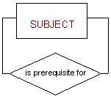
Relationships - Unary
The three most common relationships in ER models are Binary, Unary, and Ternary
A unary relationship is when both participants in the relationship are the same entity.

Slide 53
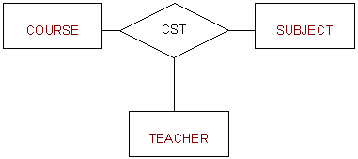
Relationships - Ternary
The three most common relationships in ER models are Binary, Unary, and Ternary
A ternary relationship is when three entities participate in the relationship.

Slide 54

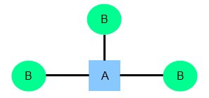
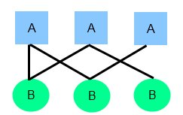
Relationships
There are three degrees of relationship
one-to-one (1:1)
one-to-many (1:M)
many-to-many (M:N)

Slide 55
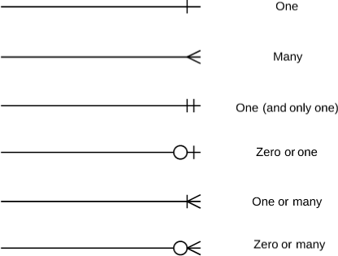
Relationships

Slide 56
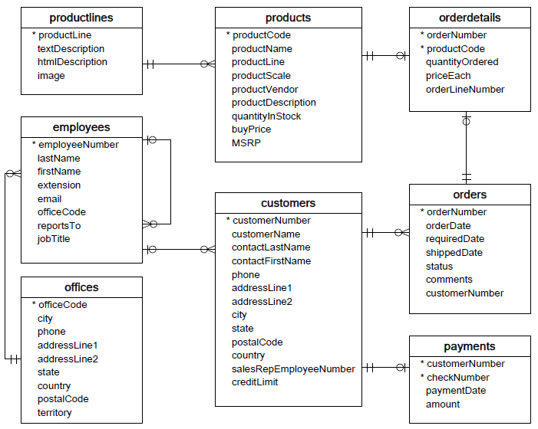

Slide 57
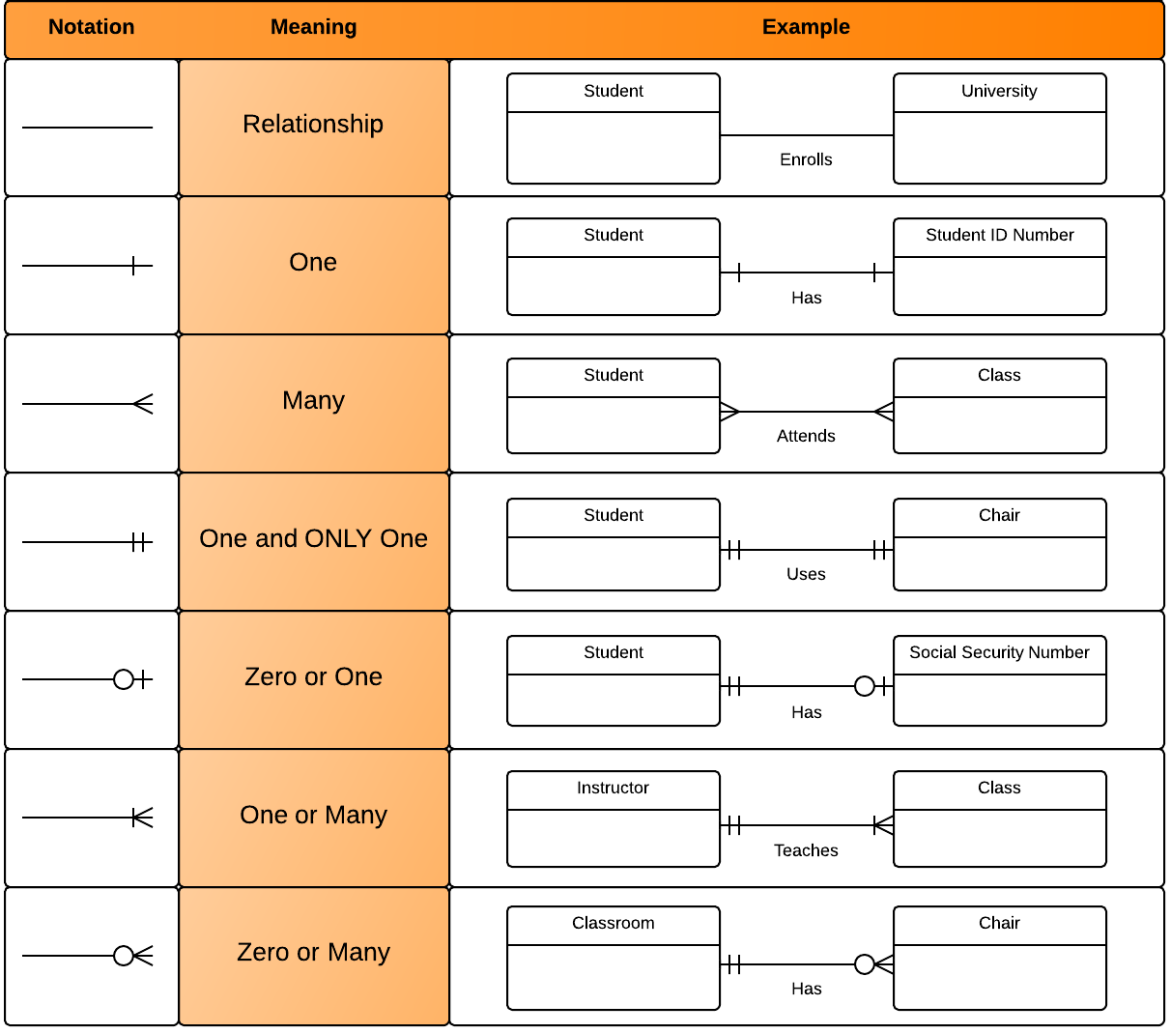
Relationships

Slide 58



one to one Relationships
The employee can manage only one department, and each department can be managed by one employee only.
personID
Name
DOB Gender
Nationality
passportID
personID (not null, unique, and foreign key)
passportNumber issueDate
expireDate

Slide 59

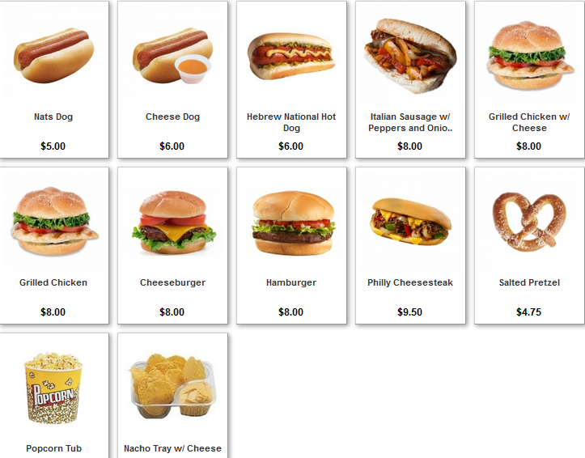
one to many Relationships
The customer may place many orders, but each order can be placed by one customer only.
personID
Name
DOB Gender
Nationality
orderID
personID (foreign key)
Name
Qty
OrderDate

Slide 60

many to one Relationships
The department may have many employees, but each employee can work only in one department.

Slide 61



many to many Relationships
One student may belong to more than one student organizations, and one organization can admit more than one student.

Slide 62
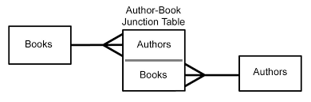
many to many Relationships

Slide 63
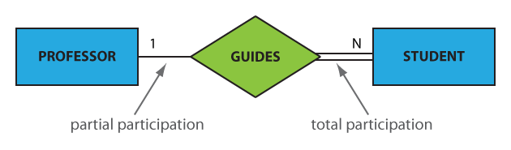
Participation constraints
An entity may participate in a relation either totally or partially.
Total participation means that every entity is involved in the relationship, e.g., each student must be guided by a professor (there are no students who are not guided by any professor. This kind of relation is represented as a double line.
Partial participation means that not all entities are involved in the relationship, e.g., not every professor guides a student (there are professors who don’t). A partial participation is represented by a single line.

Slide 64
What is Schema?

Slide 65
What is Schema?
A schema is a collection of database objects associated with one particular database username. This username is called the schema owner, or the owner of the related group of objects. You may have one or multiple schemas in a database.

Slide 66
What is Data Modeling?
Data modeling is the process of creating a data model for the data to be stored in a Database. This data model is a conceptual representation of
Data objects
The associations between different data objects
The rules.

Slide 67
Data Modeling
Data modeling is a process used to define and analyze data requirements needed to support the business processes within the scope of corresponding systems in organizations.
Data modeling involves a progression from conceptual model to logical model to physical object.

Slide 68
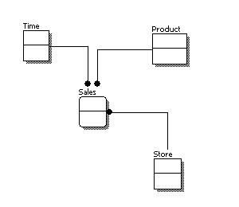
Conceptual Model Design
Features of conceptual data model include:
Includes the important entities and the relationships among them.
No attribute is specified.
No primary key is specified.

Slide 69
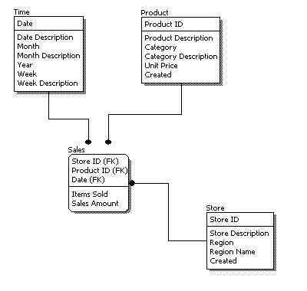
Logical Model Design
Features of logical data model include:
Includes all entities and relationships among them.
All attributes for each entity are specified.
The primary key for each entity is specified.
Foreign keys are specified.

Slide 70
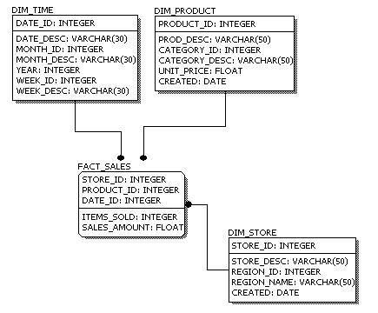
Physical Model Design
Features of physical data model include:
Convert entities into tables.
Convert relationships into foreign keys.
Convert attributes into columns.

Slide 71
Data Modeling
Feature | Conceptual | Logical | Physical
Entity Names | ✓ | ✓
Entity Relationships | ✓ | ✓
Attributes |  | ✓
Primary Keys |  | ✓ | ✓
Foreign Keys |  | ✓ | ✓
Table Names |  |  | ✓
Column Names |  |  | ✓
Column Data Types |  |  | ✓

Slide 72
Branch { branch-ID, branch-name, branch-city, assets }
Customer { customer-id, customer-name, customer-street, customer-only }
Account { account-number, branch-ID, balance }
Loan { loan-number, branch-ID, amount }
Depositor { customer-id, account-number }
Borrower { customer-id, loan-number }
Relational Algebra
∧ (and), ∨ (or), ¬ (not)

Slide 73
Relational Algebra
Select (sigma)
Project (pi)
Union
Set different
Cartesian product
Rename
(σ)
(∏)
(∪)
(−)
(Χ)
(ρ)

Slide 74
SELECT
(σ)
Select
Notation − σ_{p}(r)
σ_{condition}(r)
σ would represent the SELECT command
_{p} would represent the condition for selection.
(r) would represent the Relation or the Table from which we are making a selection of the tuples.
Select the EMPLOYEE whose employee number is 7, or those whose date of birth is ‘01-Jan-1980’
(r)=σ_{empno=7}(EMPLOYEE)
(r)=σ_{dob<=’01-Jan-1980′}(EMPLOYEE)
(r)=σ_{empno=7 ∨ dob=’01-Jan-1980′}(EMPLOYEE)
Returns the result to new relation.

Slide 75
SELECT
(σ)
Select
Notation − σ_{p}(r)
σ_{condition}(r)
Select the EMPLOYEE tuples whose employee number is > 7 and department ID is 10
(r)=σ_{deptno=10} [σ_{empno>7}(EMPLOYEE)]
(r)=σ_{empno>7 ^ deptno=10}(EMPLOYEE)

Slide 76
PROJECT
Project
(∏)
Notation − ∏_{A1, A2, An} (r)
∏_{<attribute-list>}(r)
∏ would represent the ROJECT.
<attribute list> would represent the attributes(columns) we want from a relational.
(r) would represent the Relation or the Table from which we are making a selection of the tuples.
Select Date of Birth (dob) and Employee Number (empno) from the relation EMPLOYE or Select Date of Birth (dob) and Employee Number (empno) from the relation EMPLOYE whose date of birth is before 1980
(r)=∏_{dob, empno}(EMPLOYEE)
(r)=∏_{dob, empno} [σ_{dob<’01-Jan-1980′}(EMPLOYEE)]

Slide 77
UNION
Union
(∪)
Notation − r U s
∏_{<attribute-list>}(r) U ∏_{<attribute-list>}(S)
r, and s must have the same number of attributes.
Attribute domains must be compatible.
Duplicate tuples are automatically eliminated.
Selects the customer name who have either purchased a book or a computer or both.
(r)=∏ _{cName} (BOOK) ∪ ∏ _{cName} (COMPUTER)

Slide 78
INTERSECTION
Intersection
Notation − r ∩ s
(∩)
∏_{<attribute-list>}(r) ∩ ∏_{<attribute-list>}(S)
r, and s must have the same number of attributes.
Attribute domains must be compatible.
Duplicate tuples are automatically eliminated.
Projects the customer name who have purchased a book and a computer both.
(r)=∏ _{cName} (BOOK) ∩ ∏ _{cName} (COMPUTER)

Slide 79
MINUS
(-)
Minus
Notation − r - s
∏_{<attribute-list>}(r) - ∏_{<attribute-list>}(S)
r, and s must have the same number of attributes.
Attribute domains must be compatible.
Duplicate tuples are automatically eliminated.
Projects the customer name who have purchased a BOOK but not a COMPUTER.
Projects the customer name who have purchased a COMPUTER but not a BOOK.
(r)=∏ _{cName} (BOOK) - ∏ _{cName} (COMPUTER)
(r)=∏ _{cName} (COMPUTER) - ∏ _{cName} (BOOK)

Slide 80
CARTESIAN PRODUCT
Cartesian product
(Χ)
Notation − r Χ s
∏_{<attribute-list>}(r) X ∏_{<attribute-list>}(S)

Slide 81
Examples Queries
Find all loans of over $1200
(r)=_{amount > 1200} (loan)
Find the loan number for each loan of an amount greater than $120
(r)=_{loan-number} (_{amount} _{> 1200} (loan))

Slide 82
Examples Queries
Find the names of all customers who have a loan, an account, or both, from the bank
_{customer-name} (borrower)  _{customer-name} (depositor)
Find the names of all customers who have a loan and an
account at bank.
_{customer-name} (borrower)  _{customer-name} (depositor)

Slide 83
Closure of Attributes

Slide 84
Closure of attributes
R (A B C D E F)
Relation
Attributes

Slide 85
Anomalies in DBMS
There are three types of anomalies that occur when the database is not normalized. These are – Insertion, update and deletion anomaly.

Slide 86
Anomalies in DBMS - Example
Student table.
rollno | name | branch | hod | office_tel
401 | Akon | CSE | Mr. X | 53337
402 | Bkon | CSE | Mr. X | 53337
403 | Ckon | CSE | Mr. X | 53337
404 | Dkon | CSE | Mr. X | 53337

Slide 87
INSERT, UPDATE, and DELETE ANOMALY
Insert anomaly: Suppose for a new admission, until and unless a student opts for a branch, data of the student cannot be inserted, or else we will have to set the branch information as NULL.
Also, if we have to insert data of 100 students of same branch, then the branch information will be repeated for all those 100 students.
These scenarios are nothing but Insertion anomalies.
Update anomalyWhat if Mr. X leaves the college? or is no longer the HOD of computer science department? In that case all the student records will have to be updated, and if by mistake we miss any record, it will lead to data inconsistency. This is Updation anomaly.
Delete anomaly: In our Student table, two different informations are kept together, Student information and Branch information. Hence, at the end of the academic year, if student records are deleted, we will also lose the branch information. This is Deletion anomaly.

Slide 88
Normalization in DBMS
Database Normalization is a technique that helps in designing the schema of the database in an optimal manner so as to ensure the above points. The core idea of database normalization is to divide the tables into smaller subtables and store pointers to data rather than replicating it.

Slide 89
Problem
To understand normalization in database with example tables, let’s assume that we are supposed to store the details of courses and instructors in a university.
Course code | Course venue | Instructor Name | Instructor’s phone number
CS101 | Lecture Hall 20 | Prof. Ronald | +1 6514821924
CS152 | Lecture Hall 21 | Prof. John | +1 6519272918
CS154 | CS Auditorium | Prof. Ronald | +1 6514821924
At first, this design seems to be good. However, issues start to develop once we need to modify information. For instance, suppose, if Prof. Ronald changed his mobile number. In such a situation, we will have to make edits in 2 places. What if someone just edited the mobile number against CS101, but forgot to edit it for CS154? This will lead to stale/wrong information in the database.

Slide 90
Solution
This problem, however, can be easily tackled by dividing our table into 2 simpler tables.
Table 1 (Instructor)
Instructor's ID | Instructor's name | Instructor's number
1 | Prof. Ronald | +1 6514821924
2 | Prof. John | +1 6519272918
Table 2 (Course)
Course code | Course venue | Instructor ID
CS101 | Lecture Hall 20 | 1
CS152 | Lecture Hall 21 | 2
CS154 | CS Auditorium | 1

Slide 91
First Normal Form (1NF)
The First normal form simply says that each cell of a table should contain exactly one value.
Instructor's name | Course code
Prof. Ronald | (CS101, CS154)
Prof. John | (CS152)
Here, the issue is that in the first row, we are storing 2 courses against Prof. Ronald. A better method would be to store the courses separately. This way, if we want to edit some information related to CS101, we do not have to touch the data corresponding to CS154.
Instructor's name | Course code
Prof. Ronald | CS101
Prof. Ronald | CS154
Prof. John | CS152

Slide 92
Second Normal Form (2NF)
For a table to be in second normal form, the following 2 conditions are to be met:
The table should be in the first normal form.
The primary key of the table should compose of exactly 1 column.
Let us take another example of storing student enrollment in various courses. Each student may enroll in multiple courses. Similarly, each course may have multiple enrollments.
A sample table may look like this (student name and course code)
Student name | Course code
Rahul | CS152
Rajat | CS101
Rahul | CS154
Raman | CS101

Slide 93
Second Normal Form (2NF)
As per the second normal form definition, our enrollments table above isn’t in second normal form. To achieve the same (1NF to 2NF), we can rather break it into 2 tables
Table 1 (Student)
Student name | Enrolment number
Rahul | 1
Rajat | 2
Raman | 3
Table 2 (Courses)
Course code | Enrolment number
CS101 | 2
CS101 | 3
CS152 | 1
CS154 | 1

Slide 94
Third Normal Form (3NF)
Column A is said to be functionally dependent on column B if changing the value of A may require a change in the value of B.
Here, the department column is dependent on the professor name column. This is because if in a particular row, we change the name of the professor, we will also have to change the department value.
Course code | Course venue | Instructor's name | Department
CS101 | Lecture Hall 18 | Prof. Ronald | Mathematics Department
CS152 | Auditorium building | Prof. John | Electronics Department
CS154 | Lecture Hall 19 | Prof. Ronald | Mathematics Department

Slide 95
Third Normal Form (3NF)
Here, when we changed the name of the professor, we also had to change the department column. This is not desirable since someone who is updating the database may remember to change the name of the professor, but may forget updating the department value. This can cause inconsistency in the database.
Third normal form avoids this by breaking this into separate tables
Course code | Course venue | Instructor's ID
CS101 | Lecture Hall 18 | 1
CS152 | Auditorium building, | 2
CS154 | Lecture Hall 19 | 1
Here, the third column is the ID of the professor who’s taking the course.
Instructor's ID | Instructor's Name | Department
1 | Prof. Ronald | Mathematics Department
2 | Prof. John | Electronics Department

Slide 96
Third Normal Form (3NF)
Therefore, in the third normal form, the following conditions are required:
The table should be in the second normal form.
There should not be any functional dependency.

Slide 97
If this is the data the convert in in 3NF
Business Rules.
A salesman can sale one or many products.
A salesman can sale a product in one or many regions.
A product can be sold in one or may regions.
Salesman Name | Region1 | Region2 | Region3 | Region4
Saleel | Car, Bus | Car, Bus, Cycle | Cycle, Motorcycle | Car
Rahul | Shirt, Pant, Gloves | Gloves, Book, Pencil | Pencil, Notebook | Keyboard, Mouse
Omkar | Keyboard, Mouse | Pen Drives, CD | Monitors, Scanners | Scanner, CD
Ninad | Photos, Photo Frames | Shirt, Pants, Gloves | Cycle, Motorcycle | Bus, Cycle, Car

Slide 98
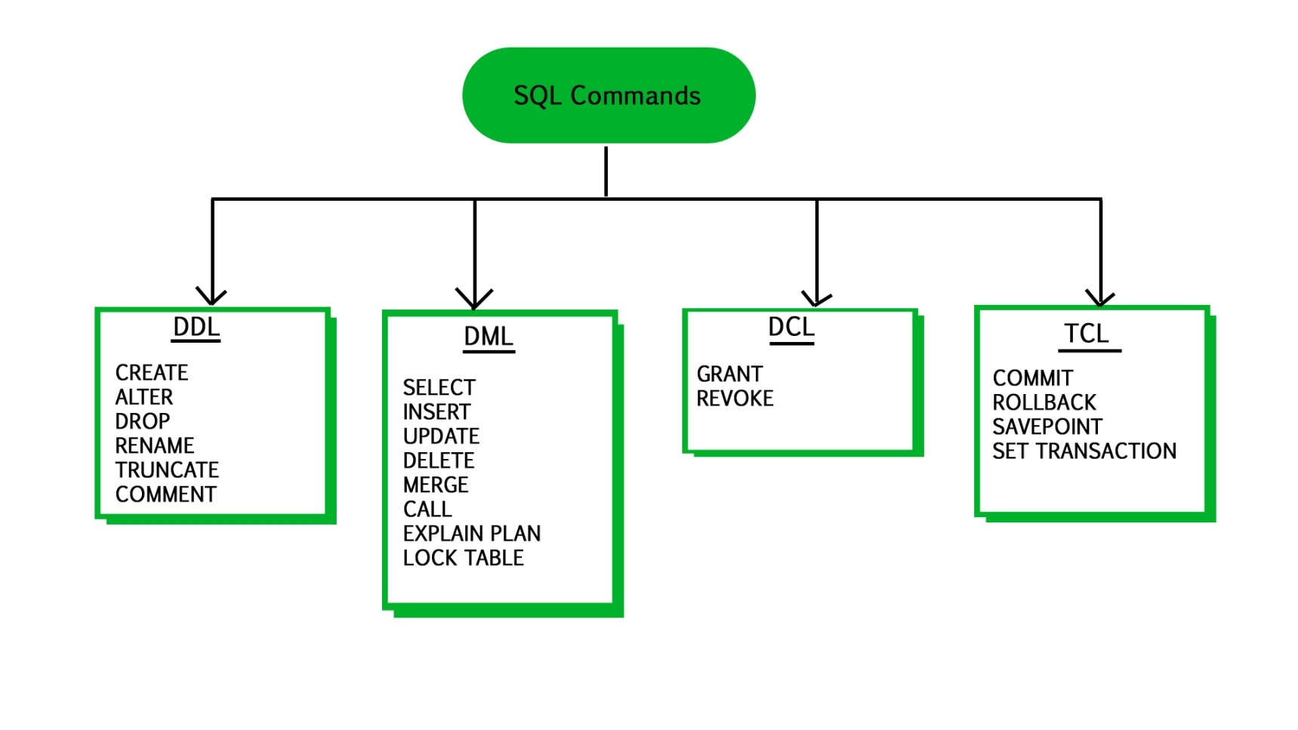
A NULL value is not treated as a blank or 0.
The number of attributes in relation is called as its Degree.
Structured Query Language is a standard Database language which is used to create, maintain and retrieve the relational database.
SQL Structured Query Language

Slide 99
What is SQL?
SQL Structured Query Language is a database language designed and developed for managing data in relational database management systems (RDBMS). SQL is common language for all Relational Databases.

Slide 100
Comments in MySQL
From a # character to the end of the line.
From a -- sequence to the end of the line.
From a /* sequence to the following */ sequence.

Slide 101
Tablespace, Control files, Data files

Slide 102
Database Storage Structures
SHOW VARIABLES LIKE 'datadir';

Slide 103
Login to MySQL

Slide 104
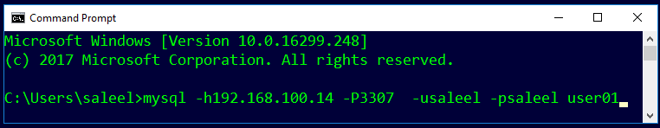
Login
Default port for MySQL Server: 3306
C:\> mysql –hstp5 –P3307 –usaleel –p user01
C:\> mysql –h192.168.100.14 –P3307 –usaleel –p user01
C:\> mysql –h192.168.100.14 –P3307 –usaleel –psaleel user01

Slide 105
Before MySQL version 5.5, MyISAM is the default storage engine when you create a table without specifying the storage engine explicitly. From version 5.5, MySQL uses InnoDB as the default storage engine.
A storage engine is a software module that a database management system uses to create, read, update data from a database. There are two types of storage engines in MySQL: transactional and non-transactional.
STORAGE ENGINES
When you create a table, MySQL creates a disk file that contains the table’s format (that is, its definition) . The format file has a basename that is the same name as the table name and an .frm extension.
Storage Engine | File on disk
MEMORY | Data is not stores on the disk
InnoDB | .idb (data and index)
MyISAM | MYD (data), .MYI (index)
CSV | .CSV (data), CSM (metadata)

Slide 106
ENGINES
MEMORY tables are visible to another client, but TEMPORARY tables are not visible to another client.
InnoDB is the most widely used storage engine with transaction support. It is the only engine which provides foreign key referential integrity constraint. Oracle recommends using InnoDB for tables except for specialized use cases.
MyISAM is the original storage engine. It is a fast storage engine. It does not support transactions. MyISAM provides table-level locking. It is used mostly in Web and data warehousing.
Memory storage engine creates tables in memory. It is the fastest engine. It provides table-level locking. It does not support transactions. Memory storage engine is ideal for creating temporary tables or quick lookups. The data is lost when the database is restarted.
CSV stores data in CSV files. It provides great flexibility because data in this format is easily integrated into other applications.

Slide 107
ENGINES
MEMORY tables are visible to another client, but TEMPORARY tables are not visible to another client.
In the case of InnoDB, it is used to store the tables in tablespace whereas, in the case of MyISAM, it stores each MyISAM table in a separate file.
In my.ini do this changes.
[mysqld]
innodb_file_per_table = 1
Tablespace: A data file that can hold data for one or more InnoDB tables and associated indexes.
System tablespace
File per tablespace
General tablespace
Note:- By default, InnoDB contains only one tablespace called the System tablespace whose identifier is 0

Slide 108
SHOW ENGINES Syntax
For MySQL 5.5 and later, the default storage engine is InnoDB. The default storage engine for MySQL prior to version 5.5 was MyISAM.
SHOW [STORAGE] ENGINES
SHOW ENGINES displays status information about the server's storage engines. This is particularly useful for checking whether a storage engine is supported, or to see what the default engine is.
INFORMATION_SCHEMA.ENGINES
show engines;
show STORAGE engines;
INFORMATION_SCHEMA provides access to database metadata, information about the MySQL server such as the name of a database or table, the data type of a column, or access privileges.

Slide 109
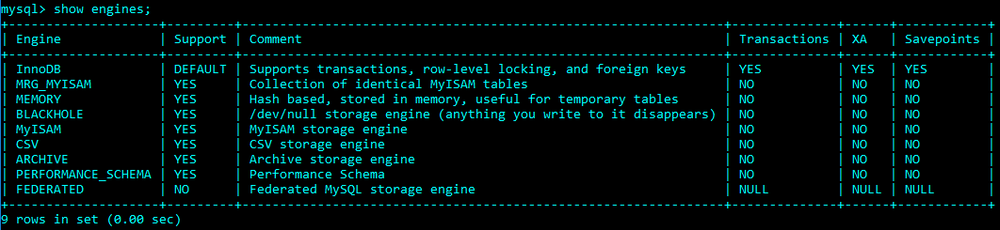
ENGINES
SET DEFAULT_STORAGE_ENGINE = InnoDB;

Slide 110
SHOW DATABASES

Slide 111
SHOW DATABASES Syntax
SHOW {DATABASES | SCHEMAS} [LIKE 'pattern' | WHERE expr]
SHOW SCHEMAS is a synonym for SHOW DATABASES.
SHOW DATABASES;
SHOW SCHEMAS;
SHOW DATABASES LIKE 'U%';
SHOW SCHEMAS LIKE 'U%';
NULL means “no database is selected”. Issue the USE dbName command to select the database.

Slide 112
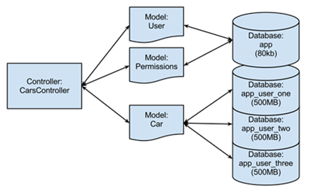
USE DATABASES
The USE db_name statement tells MySQL to use the db_name database as the default (current) database for subsequent statements. The database remains the default until the end of the session or another USE statement is issued.

Slide 113
USE DATABASES Syntax
USE db_name
USE, does not require a semicolon.
USE must be followed by a database name.
USE db1
\U db1

Slide 114
CREATE DATABASE

Slide 115
CREATE DATABASE
CREATE DATABASE creates a database with the given name. To use this statement, you need the CREATE privilege for the database.
CREATE {DATABASE | SCHEMA} [IF NOT EXISTS] db_name
CREATE SCHEMA is a synonym for CREATE DATABASE.
CREATE DATABASE db1;
CREATE DATABASE IF NOT EXISTS db1;

Slide 116
DROP DATABASE
If the default database is dropped, the default database is unset (the DATABASE() function returns NULL).

Slide 117
DROP DATABASE
DROP DATABASE drops all tables in the database and deletes the database. Be very careful with this statement! To use DROP DATABASE, you need the DROP privilege on the database.
DROP {DATABASE | SCHEMA} [IF EXISTS] db_name
DROP SCHEMA is a synonym for DROP DATABASE.
DROP DATABASE db1;
DROP DATABASE IF EXISTS db1;

Slide 118
Information Functions
Use these function with SELECT statement

Slide 119
Information Functions
FOUND_ROWS() - For a SELECT with a LIMIT clause, the number of rows that would be returned were there no LIMIT clause
LAST_INSERT_ID() - Value of the AUTOINCREMENT column for the last INSERT
ROW_COUNT() - The number of rows updated
DATABASE() - Return the default (current) database name
SCHEMA() - Synonym for DATABASE()
SELECT database();

Slide 120
mysqlshow [options] [db_name [tbl_name [col_name]]]
mysqlshow.exe
.
The mysqlshow client can be used to quickly see which databases exist, their tables, or a table's columns or indexes

Slide 121
SELECT …. For UPDATE

Slide 122
SELECT - for UPDATE
SELECT * FROM EMP for UPDATE;

Slide 123
The HAVING clause is often used with the GROUP BY clause to filter groups based on a specified condition. If the GROUP BY clause is omitted, the HAVING clause behaves like the WHERE clause.
The HAVING clause can refer to aggregate functions, which the WHERE clause cannot.
HAVING Clause
If the GROUP BY clause is omitted, the HAVING clause behaves like the WHERE clasue.

Slide 124
SELECT - HAVING
The MySQL HAVING clause is used in the SELECT statement to specify filter conditions for a group of rows. HAVING clause is often used with the GROUP BY clause. When using with the GROUP BY clause, we can apply a filter condition to the columns that appear in the GROUP BY clause.
If the GROUP BY clause is omitted, the HAVING clause behaves like the WHERE clause.
SELECT G₁, G₂, . . . , F₁(A₁), F₂(A₂), . . . from r₁, r₂, r₃ . . .
[GROUP BY {G₁, G₂, . . . | expr | position} [ASC | DESC], ... [WITH ROLLUP]]
[ HAVING having_condition ]

Slide 125
When WHERE and HAVING clause are used together in a SELECT query with aggregate function, WHERE clause is applied first on individual rows and only rows which pass the condition is included for creating groups. Once group is created, HAVING clause is used to filter groups based upon condition specified.
Difference between WHERE and HAVING clause

Slide 126
WHERE and HAVING clause
WHERE clause can be used with - SELECT, UPDATE, and DELETE statements, where as HAVING clause can only be used with the SELECT statement.
WHERE clause filters rows before aggregation (GROUPING), where as, HAVING clause filters groups, after the aggregations are performed.
Aggregate functions (SUM , MIN, MAX, AVG and COUNT) cannot be used in the WHERE clause condition, unless it is in a subquery contained in a HAVING clause, whereas, aggregate functions can be used in HAVING clause.
The Where clause acts as a pre filter where as Having clause acts as a post filter.

Slide 127
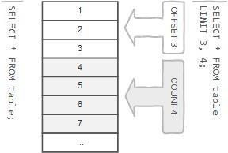
Row Limiting Clause
LIMIT is applied after HAVING
LIMIT also enables you to pull a section of rows from the middle of a result set. Specify two values: The number of rows to skip at the beginning of the result set, and the number of rows to return.

Slide 128
SELECT - LIMIT
Limit value are not to be given within ()
The LIMIT clause can be used to constrain the number of rows returned by the SELECT statement. LIMIT takes one or two numeric arguments, which must both be nonnegative integer value.
SELECT column-list from <table_references>
[LIMIT {[offset,] row_count | row_count OFFSET offset}]
You can specify an offset using OFFSET from where SELECT will start returning records. By default offset is zero.
The first argument specifies the offset of the first row to return, and the second specifies the maximum number of rows to return.
SELECT * FROM EMP LIMIT 5;
SELECT * FROM EMP LIMIT 1, 5;
SELECT * FROM EMP LIMIT 5 offset 1;
SELECT rand(), EMP.* FROM EMP ORDER BY 1 LIMIT 1;

Slide 129
SELECT - LIMIT
This variable is used to return the maximum number of rows from SELECT statements. Its default value is unlimited. But if you changed the limit then SELECT statement returns the rows equals to the value.
SQL_SELECT_LIMIT = {value | DEFAULT}
This variable does not apply to SELECT statement that executed in the stored procedures or functions.
SET SQL_SELECT_LIMIT=2;
SET SQL_SELECT_LIMIT=DEFAULT;
SELECT * FROM EMP;

Slide 130
window function

Slide 131
window function
TODO
RANK() OVER([PARTITION BY expr [, expr] ... ORDER BY expr [ASC | DESC] [, expr [ASC | DESC]] ...])
DENSE_RANK() OVER([PARTITION BY expr [, expr] ... ORDER BY expr [ASC|DESC] [, expr [ASC | DESC]] ...])
ROW_NUMBER() OVER([PARTITION BY expr [, expr] ... ORDER BY expr [ASC|DESC] [, expr [ASC | DESC]] ...])

Slide 132
User-Defined Variables

Slide 133
User-Defined Variables
A user variable name can contain other characters if you quote it as a string or identifier (for example, @'my-var', @"my-var", or @`my-var`).
User-defined variables are session specific. A user variable defined by one client cannot be seen or used by other clients.
All variables for a given client session are automatically freed when that client exits.
User variable names are not case sensitive. Names have a maximum length of 64 characters.
If the value of a user variable is selected in a result set, it is returned to the client as a string.
If you refer to a variable that has not been initialized, it has a value of NULL and a type of string.

Slide 134
User-Defined Variables
You can store a value in a user-defined variable in one statement and refer to it later in another statement. This enables you to pass values from one statement to another.
SET @var_name = expr [, @var_name = expr] ...
For SET, either = or := can be used as the assignment operator.
You can also assign a value to a user variable in statements (SELECT, …) other than SET. In this case, the assignment operator must be := and not = because latter is treated as the comparison operator =.
mysql> SET @v1 = 1001, @v2 = 2, @v3 = 'Saleel';
mysql> SET @v1 = 1001, @v2 = 2, @v3 := @v1 + @v2;
mysql> SELECT @v1 := MIN(SAL), @v2 := MAX(SAL) FROM EMP;
mysql> SELECT @v1, @v2, @v3;

Slide 135

User-Defined Variables
User variables are intended to provide data values. They cannot be used directly in an SQL statement as an identifier or as part of an identifier.
SET @var_name = expr [, @var_name = expr] ...
mysql> SET @v1 = 'ENAME'; // ENAME IS COLUMN NAME.
mysql> SELECT @v1 FROM EMP;

Slide 136
Rownum
mysql> SELECT * FROM (SELECT @cnt := @cnt + 1 R1, EMP.* FROM EMP, (SELECT @cnt := 0) T1) T2 WHERE R1 > @cnt - 7;

Slide 137
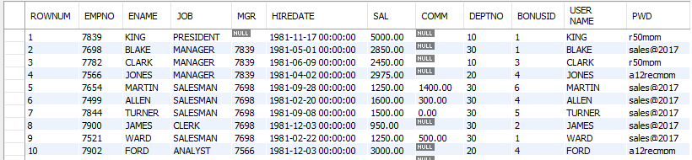
Select - Rownum
mysql> SET @ROW = 0;
mysql> SELECT @ROW := @ROW + 1 AS ROWNUM , EMP.* FROM EMP;
mysql> SELECT @ROW := @ROW + 1 AS ROWNUM , EMP.* FROM EMP,
(SELECT @ROW := 0) AS E;
mysql> SELECT @rank := @rank + 1 ,E.* FROM (SELECT JOB, SAL FROM EMP
GROUP BY JOB ORDER BY SAL desc) E , (SELECT @rank := 0) EE;

Slide 138
Questions?

Slide 139
Prepared SQL Statement

Slide 140
Prepared SQL Statement
The PREPARE statement prepares a SQL statement and assigns it a name, stmt_name. The prepared statement is executed with EXECUTE and released with DEALLOCATE PREPARE.
PREPARE stmt_name FROM preparable_stmt
EXECUTE stmt_name
[USING @var_name [, @var_name] ...]
{DEALLOCATE | DROP} PREPARE stmt_name

Slide 141
Prepared SQL Statement
Example of prepared statement
PREPARE stat1 from 'SELECT * from EMP';
EXECUTE stat1;
SET @x := 'SELECT * from EMP where deptno = 10';
PREPARE stat1 from @x;
EXECUTE stat1;
SET @x:=10;
PREPARE stat1 from 'SELECT * from EMP where deptno = ?';
EXECUTE stat1 using @x;
SET @x:=10, @y := 3000;
PREPARE stat1 from 'SELECT * from EMP where deptno = ? and sal >= ?';
EXECUTE stat1 using @x, @y;
DEALLOCATE PREPARE stat1;

Slide 142
SELECT ... INTO

Slide 143
mysqlshow [options] [db_name [tbl_name [col_name]]]
mysqlshow.exe
.
The mysqlshow client can be used to quickly see which databases exist, their tables, or a table's columns or indexes

Slide 144
mysqlshow.exe
mysqlshow – Get Quick Info On MySQL DB, Table, Column and Index
[Display available databases]
mysqlshow -hlocalhost -P3306 -uroot –proot
[Display all tables in a database]
mysqlshow -hlocalhost -P3306 -uroot -proot db1
[Display tables along with number of columns in a database]
mysqlshow -hlocalhost -P3306 -uroot -proot db1 –v
[Display total number of columns and rows of all tables in a database]
mysqlshow -hlocalhost -P3306 -uroot -proot db1 –v –v

Slide 145
mysqlshow.exe
mysqlshow – Get Quick Info On MySQL DB, Table, Column and Index
[Display all columns of a table]
mysqlshow -hlocalhost -P3306 -uroot -proot db1 EMP
[Display details about a specific column from a table]
mysqlshow -hlocalhost -P3306 -uroot -proot db1 EMP empno
[Display both indexes and columns of a table]
mysqlshow -hlocalhost -P3306 -uroot -proot db1 EMP –k

Slide 146
Information Functions
CURRENT_USER(), CURRENT_USER - The authenticated user name and host name
USER() - The user name and host name provided by the client
SESSION_USER() - Synonym for USER()
SYSTEM_USER() - Synonym for USER()
VERSION() - Return a string that indicates the MySQL server version
CONNECTION_ID() - Return the connection ID (thread ID) for the connection
SELECT user();

Slide 147
Source Command

Slide 148
Source command
You can execute an SQL script file using the source command or \. command
\. file_name
source file_name
\. 'D:\MySQLDEMOBLD7.SQL'
SOURCE 'D:\MySQLDEMOBLD7.SQL‘
SOURCE //infoserver1/infodomain1/Everyone/DBT/MySQLDEMOBLD7.SQL

Slide 149
SHOW COLUMNS

Slide 150
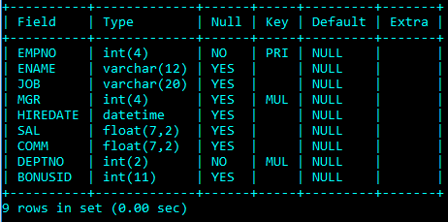
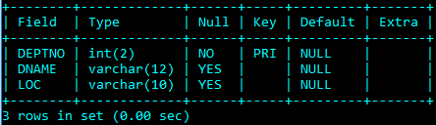
EMP & DEPT Table structure

Slide 151
SHOW COLUMNS Syntax
SHOW [FULL] {COLUMNS | FIELDS} {FROM | IN} tbl_name [{FROM | IN} db_name] [LIKE 'pattern' | WHERE expr]
show columns from EMP;
show columns in EMP;
show full columns from EMP; // with Privileges
show columns from EMP from user01;
show columns from user01.EMP;
show columns from EMP like 'E%'; // starting with E
show columns from EMP where field in ('ename'); // only ename column

Slide 152
SHOW TABLES

Slide 153
SHOW TABLES Syntax
SHOW [FULL] TABLES [{FROM | IN} db_name] [LIKE 'pattern' | WHERE expr]
show tables;
show full tables; // with Table Type
show tables from user01;
show tables where tables_in_user01 like 'e%' or tables_in_user01 like 'B%';
show tables where tables_in_user01 in ('EMP');

Slide 154
SHOW TABLES STATUS

Slide 155
SHOW TABLES STATUS Syntax
SHOW TABLE STATUS [{FROM | IN} db_name] [LIKE 'pattern' | WHERE expr]
show table status;
show table status from user01;
show table status in user01;
show table status like 'EMP';

Slide 156
SHOW VARIABLES
shows the values of MySQL system variables.

Slide 157
SHOW VARIABLES Syntax
SHOW [GLOBAL | SESSION] VARIABLES [LIKE 'pattern' | WHERE expr]
SET SQL_SAFE_UPDATES = 0;
SET SQL_SAFE_UPDATES = false;
Enable/Disable :- 1 (for true) / 0 (for false)

Slide 158
SHOW [GLOBAL | SESSION] VARIABLES [LIKE 'pattern' | WHERE expr]

Slide 159
Explain

Slide 160
Explain
The DESCRIBE and EXPLAIN statements are synonyms. In practice, the DESCRIBE keyword is more often used to obtain information about table structure, whereas EXPLAIN is used to obtain a query execution plan.
{EXPLAIN | DESCRIBE | DESC}
tbl_name [col_name]
DESC EMP;
DESC EMP ENAME;
DESCRIBE EMP;
EXPLAIN EMP;
EXPLAIN EMP empno;
EXPLAIN works with SELECT, DELETE, INSERT, REPLACE, and UPDATE statements.

Slide 161
Explain
The DESCRIBE and EXPLAIN statements are synonyms. In practice, the DESCRIBE keyword is more often used to obtain information about table structure, whereas EXPLAIN is used to obtain a query execution plan.
{EXPLAIN | DESCRIBE | DESC}
{explainable_stmt}
explainable_stmt: {
SELECT statement
| DELETE statement
| INSERT statement
| REPLACE statement
| UPDATE statement
}
EXPLAIN SELECT * FROM EMP;
EXPLAIN SELECT * FROM EMP where empno=7788;
EXPLAIN SELECT * FROM EMP INNER JOIN DEPT USING(DEPTNO);

Slide 162
SELECT statement…

Slide 163
SELECT CLAUSE
The SELECT statement retrieves or extracts data from tables in the database.
You can use one or more tables separated by comma to include various conditions using a WHERE clause, but WHERE clause is an optional part of SELECT command.
You can fetch one or more fields in a single SELECT command.
You can specify star (*) in place of fields. In this case, SELECT will return all the fields.
You can specify any condition using WHERE clause.
You can specify an offset using OFFSET from where SELECT will start returning records. By default offset is zero.
You can limit the number of returns using LIMIT attribute.

Slide 164
Capabilities of SELECT Statement
SELECTION
PROJECTION
JOINING

Slide 165
Capabilities of SELECT Statement
SELECTION
Selection capability in SQL is to choose the rows in a table that you want to return by a query.
EMPNO | ENAME | JOB | HIREDATE
1 | Saleel | Manager | 01-Jan-95
2 | Janhavi | Sales | 20-Dec-94
3 | Snehal | Manager | 21-May-97
4 | Rahul | Account | 30-Jul-97
5 | Ketan | Sales | 01-Jan-94

Slide 166
Capabilities of SELECT Statement
PROJECTION
Projection capability in SQL to choose the columns in a table that you want to return by your query.
EMPNO | ENAME | JOB | HIREDATE
1 | Saleel | Manager | 01-Jan-95
2 | Janhavi | Sales | 20-Dec-94
3 | Snehal | Manager | 21-May-97
4 | Rahul | Account | 30-Jul-97
5 | Ketan | Sales | 01-Jan-94

Slide 167
Capabilities of SELECT Statement
JOINING
Join capability in SQL to bring together data that is stored in different tables by creating a link between them.
EMPNO | ENAME | JOB | HIREDATE | DEPTNO
1 | Saleel | Manager | 01-Jan-95 | 20
2 | Janhavi | Sales | 20-Dec-94 | 10
3 | Snehal | Manager | 21-May-97 | 10
4 | Rahul | Account | 30-Jul-97 | 20
5 | Ketan | Sales | 01-Jan-94 | 30
DEPTNO | DNAME | LOC
10 | HRD | PUNE
20 | SALES | BARODA

Slide 168
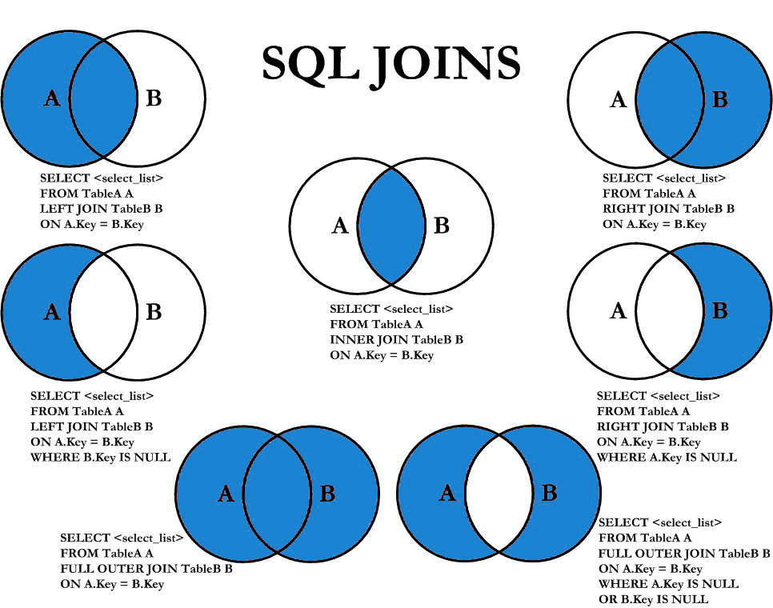

Slide 169
SELECT statement
SELECTION Process
SELECT * FROM <table_references>
Selection-List
PROJECTION Process
SELECT column-list FROM <table_references>
Selection-List

Slide 170
In the select list of a query, a quoted column alias can be specified using identifier ( ` ) or string quoting ( ' or " ) characters.
Column - ALIAS
SELECT 'HELLO' ' WORLD';
SELECT 'HELLO' AS ' WORLD';
SELECT ENAME `EmployeeName` FROM EMP;
SELECT ENAME AS `EmployeeName` FROM EMP;

Slide 171
SELECT statement - ALIAS
A programmer can use an alias to temporarily assign another name to a table or column for the duration of a SELECT query. Assigning an alias does not actually rename the column or table.
A select_expr can be given an alias using AS alias_name. The alias is used as the expression's column name and can be used in GROUP BY, ORDER BY, or HAVING clauses.
The AS keyword is optional when aliasing a select_expr with an identifier.
Standard SQL disallows references to column aliases in a WHERE clause.
A table reference can be aliased using tbl_name AS alias_name or tbl_name alias_name
If the column alias contains spaces, put it in quotes.

Slide 172
SELECT statement - ALIAS
SQL aliases are used to give a table, or a column in a table, a temporary name.
Column ALIAS
SELECT ColName1 [ [as] alias_name], ColName2 [ [as] alias_name],... ColN from <table_references> [ [as] alias_name]
SELECT EMPNO as EmployeeNumber, ENAME EmployeeName FROM EMP;
SELECT ENAME "Employee Name" FROM EMP;
SELECT ENAME 'Employee Name' FROM EMP;
SELECT * FROM EMP E;
You can use the alias in GROUP BY, ORDER BY, or HAVING clauses to refer to the column.
Standard SQL disallows references to column aliases in a WHERE clause.

Slide 173
SELECT statement - ALIAS
SQL aliases are used to give a table, or a column in a table, a temporary name.
Column ALIAS
You can use the alias in GROUP BY, ORDER BY, or HAVING clauses to refer to the column.
SELECT orderNumber `Order no.`, SUM(price * quantity) total
FROM orderdetails
GROUP BY `Order no.`
HAVING total > 60000;

Slide 174
select ename, substr(ename,1, 4), hex(substr(ename,1, 4)), cast(unhex(hex(substr(ename,1, 4))) as char(1000) CHARACTER SET utf8) from emp;
Column - EXPRESSIONS
"Strings are automatically converted to numbers and numbers to strings as necessary." This means that in order to compare a string to a number, it tries to parse a number from the start of the string. In this case there is no number there, so it converts to 0, and 0 = 0 is true.

Slide 175
SELECT statement - EXPRESSIONS
Column EXPRESSIONS
SELECT ColName1, expressions,... from <table_references>
SELECT 1001 + 1;
SELECT 1001 + 1 FROM DUAL;
SELECT '1' + '1' ;
SELECT '1' + 'a1';
SELECT '1' + '1a';
SELECT 'a1' + 1;
SELECT '1a' + 1;
SELECT SAL, SAL + 1000 AS 'New Salary' FROM EMP;
SELECT SAL, COMM, SAL + COMM FROM EMP;
SELECT SAL, COMM, SAL + IFNULL (COMM, 0) FROM EMP;

Slide 176
Comparison Functions and Operator

Slide 177
Comparison Functions and Operator
BETWEEN ... AND ... | Check whether a value is within a range of values
COALESCE() | Return the first non-NULL argument
= | Equal operator
<=> | NULL-safe equal to operator
> | Greater than operator
>= | Greater than or equal operator
IN() | Check whether a value is within a set of values
IS | Test a value against a boolean
IS NOT | Test a value against a boolean
IS NOT NULL | NOT NULL value test
IS NULL | NULL value test
ISNULL() | Test whether the argument is NULL
< | Less than operator
<= | Less than or equal operator
LIKE | Simple pattern matching
NOT BETWEEN ... AND ... | Check whether a value is not within a range of values
!=, <> | Not equal operator
NOT IN() | Check whether a value is not within a set of values
NOT LIKE | Negation of simple pattern matching

Slide 178
BETWEEN ... AND ...
Check whether a value is within a range of values
All three expressions: expr, begin_expr, and end_expr must have the same data type.
Comparison BETWEEN ... AND ...
If any expression is NULL, the BETWEEN operator returns a NULL value.

Slide 179
IS
Tests a value against a boolean value, where boolean_value can be TRUE, FALSE, or UNKNOWN.
Comparison IS

Slide 180
Identifier Qualifiers
The maximum length for each type of identifier like (Database, Table, Column, Index, Constraint, View, Stored Program, User-Defined Variable, Tablespace) is 64 characters, whereas for Alias is 256 characters.

Slide 181
Identifier Qualifiers
You can refer to a table within the default database as tbl_name, or as db_name.tbl_name to specify a database explicitly.
You can refer to a column as col_name, tbl_name.col_name, or db_name.tbl_name.col_name.
You need not specify a tbl_name or db_name.tbl_name prefix for a column reference unless the reference would be ambiguous.
The identifier quote character is the backtick (`)

Slide 182
Identifier Qualifiers
In MySQL, you can refer to a table column using any of the following forms.
Column Reference | Description
col_name | The column col_name from whichever table used in the statement contains a column of that name.
tbl_name.col_name | The column col_name from table tbl_name of the default database.
db_name.tbl_name.col_name | The column col_name from table tbl_name of the database db_name.
The identifier quote character is the backtick (`)

Slide 183
Identifier Qualifiers
In MySQL, you can refer to a table using any of the following forms.
Table Reference | Description
tbl_name | The table tbl_name from whichever table used in the statement to fetch the data.
db_name.tbl_name | The table tbl_name from whichever database db_name.
The identifier quote character is the backtick (`)

Slide 184
The NULL value

Slide 185
The NULL value - NULL
The NULL value is special. It means "NO VALUE" or "UNKNOWN VALUE" and cannot be compared to known values the way you compere two known values to each other. If you attempt to use NULL with the usual arithmetic comparison operators, the result is undefined (NULL).
Instead of using =, < >, or != to test for equality or inequality with NULL values, use IS NULL or IS NOT NULL
MySQL specific <=> comparison operator is true even for NULL-to-NULL comparisons.

Slide 186
Control Flow Functions

Slide 187
Control Flow Functions - IFNULL
IFNULL function
MySQL IFNULL() takes two expressions, if the first expression is not NULL, it returns the first expression. Otherwise, it returns the second expression, it returns either numeric or string value.
IFNULL(expression1, expression2)
SELECT IFNULL (1, 2) as R1;
SELECT IFNULL (null, 2) as R1;
SELECT IFNULL (1/0, 2) as R1;
SELECT IFNULL (1/0, 'Yes') as R1;
SELECT comm, IFNULL(COMM + COMM*.25, 1000) FROM EMP;

Slide 188
Control Flow Functions - IF
IF function
If expr1 is TRUE or expr1 <> 0 or expr1 <> NULL, then IF() returns expr2, otherwise it returns expr3, it returns either numeric or string value.
IF(expr1, expr2 , expr3)
SELECT IF(1 > 2, 2, 3) as R1;
SELECT sal, IF(sal = 3000, 'Ok', 'Not Bad') R1 FROM EMP;
SELECT ename, sal, IF(sal = 3000 and ename = 'FORD', 'Y', 'N') R1 FROM EMP;
SELECT ename, sal, comm, IF(comm is NULL && ename = 'FORD', 'Y', 'N') R1 FROM EMP;
SELECT deptno, IF(deptno = 10, 'Sales', IF(deptno = 20 , 'Purchase' ,'N/A')) R1 FROM EMP;

Slide 189
Control Flow Functions - NULLIF
NULLIF function
Returns NULL if expr1 = expr2 is true, otherwise returns expr1.
NULLIF(expr1, expr2)
SELECT NULLIF(1, 1) as R1;
SELECT NULLIF(1, 2) as R1;

Slide 190
Control Flow Functions - CASE
CASE function
Returns the result for the first condition that is true. If there was no matching result value, the result after ELSE is returned, or NULL if there is no ELSE part.
CASE value WHEN [compare_value] THEN result [WHEN [compare_value] THEN result ...] [ELSE result] END
SELECT deptno, CASE deptno when 10 then 'Accounts' when 20 then 'Sales' ELSE 'N/A' END R1 FROM EMP;
SELECT deptno, CASE deptno when 10 then 'Accounts' ELSE 'N/A' END CASE FROM EMP; // error

Slide 191
Control Flow Functions - CASE
CASE function
Returns the result for the first condition that is true. If there was no matching result value, the result after ELSE is returned, or NULL if there is no ELSE part.
CASE WHEN [condition] THEN result [WHEN [condition] THEN result ...] [ELSE result] END
SELECT deptno, CASE when deptno = 10 then 'Sales' when deptno = 20 then 'Purchase' ELSE 'N/A' END R1 FROM EMP;

Slide 192
Date and Time Functions

Slide 193
NOW(), CURDATE(), CURTIME()
DateTime Functions
In MySQL, the NOW() function returns a default value for a DATETIME.
MySQL inserts the current date and time into the column whose default value is NOW().
In MySQL, the CURDATE() returns the current date in 'YYYY-MM-DD'. CURRENT_DATE() and CURRENT_DATE are the synonym of CURDATE().
In MySQL, the CURTIME() returns the value of current time in 'HH:MM:SS'. CURRENT_TIME() and CURRENT_TIME are the synonym of CURTIME().

Slide 194
NOW(), CURDATE(), CURTIME()
DateTime Functions
SELECT NOW()
SELECT CURDATE()
SELECT CURTIME()
Result in something like this:
NOW() CURDATE() CURTIME()
2017-02-11 10:22:31 2017-02-11 10:22:31

Slide 195
Date()
DateTime Functions
The DATE() function extracts the date value from a date or datetime expression.
DATE(expr)
SELECT DATE("2017-06-15 09:34:21")
SELECT NOW(), DATE (NOW())
Returns NULL if expression is not a date or a datetime value.

Slide 196
+ or - operator
DateTime Functions
Date arithmetic also can be performed using INTERVAL together with the + or - operator
date + INTERVAL expr unit / date - INTERVAL expr unit
SELECT NOW(), NOW() + INTERVAL 1 DAY;
unit Value | ExpectedexprFormat
SECOND | SECONDS
MINUTE | MINUTES
HOUR | HOURS
DAY | DAYS
WEEK | WEEKS
MONTH | MONTHS
QUARTER | QUARTERS
YEAR | YEARS

Slide 197
ADDDATE()
DateTime Functions
ADDDATE() is a synonym for DATE_ADD().
ADDDATE(date, INTERVAL expr unit) / ADDDATE(expr, day)
SELECT NOW(), ADDDATE(NOW(), interval 1 DAY)
unit Value | ExpectedexprFormat
SECOND | SECONDS
MINUTE | MINUTES
HOUR | HOURS
DAY | DAYS
WEEK | WEEKS
MONTH | MONTHS
QUARTER | QUARTERS
YEAR | YEARS

Slide 198
DATE_ADD()
DateTime Functions
DATE_ADD(date, INTERVAL expr unit)
SELECT NOW(), DATE_ADD(NOW(), interval 1 DAY)
unit Value | ExpectedexprFormat
SECOND | SECONDS
MINUTE | MINUTES
HOUR | HOURS
DAY | DAYS
WEEK | WEEKS
MONTH | MONTHS
QUARTER | QUARTERS
YEAR | YEARS

Slide 199
DATE_SUB()
DateTime Functions
DATE_SUB() is a synonym for SUBDATE().
DATE_SUB(date, INTERVAL expr unit)
SELECT NOW(), DATE_SUB(NOW(), interval 1 DAY);
unit Value | ExpectedexprFormat
SECOND | SECONDS
MINUTE | MINUTES
HOUR | HOURS
DAY | DAYS
WEEK | WEEKS
MONTH | MONTHS
QUARTER | QUARTERS
YEAR | YEARS

Slide 200
ADDTIME()
DateTime Functions
ADDTIME() adds expr2 to expr1 and returns the result. expr1 is a time or datetime expression, and expr2 is a time expression.
ADDTIME(expr1, expr2)
SELECT NOW(), ADDTIME(NOW(), '1:1:1') // 'HH:MM:SS'
SELECT NOW(), ADDTIME(NOW(), '2 2:10:5') // 'DAY HH:MM:SS'

Slide 201
SUBTIME()
DateTime Functions
SUBTIME() returns expr1 − expr2 expressed as a value in the same format as expr1. expr1 is a time or datetime expression, and expr2 is a time expression.
SUBTIME(expr1, expr2)
SELECT NOW(), SUBTIME(NOW(), '1:1:1') // 'HH:MM:SS'
SELECT NOW(), SUBTIME(NOW(), '2 1:1:1') // 'DAY HH:MM:SS'

Slide 202
EXTRACT
DateTime Functions
The EXTRACT() function is used to return a single part of a date/time, such as year, month, day, hour, minute, etc.
EXTRACT(unit FROM date)
Unit Value
MICROSECOND | SECOND | MINUTE | HOUR | DAY
WEEK | MONTH | QUARTER | YEAR
MINUTE_SECOND | HOUR_SECOND | DAY_SECOND | DAY_HOUR
HOUR_MINUTE | DAY_MINUTE | YEAR_MONTH
SELECT EXTRACT (DAY_MINUTE FROM NOW())
SELECT EXTRACT (YEAR_MONTH FROM NOW())

Slide 203
PERIOD_DIFF()
DateTime Functions
MySQL PERIOD_DIFF() returns the difference between two periods. Periods should be in the same format i.e. YYYYMM or YYMM.
PERIOD_DIFF(P1, P2);
SELECT PERIOD_DIFF(201701, 201601);
SELECT PERIOD_DIFF (EXTRACT (YEAR_MONTH FROM now()), EXTRACT (YEAR_MONTH FROM hiredate)) AS R1 FROM EMP;

Slide 204
from Kedar Ghadge
TIMESTAMPADD()
DateTime Functions
TODO
TIMESTAMPADD (<unit>, interval, date_time);
date_time + interval
Unit Value
YEAR | DAY | HOUR | MINUTE
SECOND | WEEK | MONTH
SELECT timestampadd (month, 2, '2017-03-26')

Slide 205
from Kedar Ghadge
TIMESTAMPDIFF()
DateTime Functions
TODO
TIMESTAMPDIFF (<unit>, date1, date2)
Date2 – Date1
Unit Value
YEAR | DAY | HOUR | MINUTE
SECOND | WEEK | MONTH
SELECT Timestampdiff (month, hiredate, now()) FROM EMP;

Slide 206
Date Functions
DateTime Functions
Syntax | Result
DAY(date) | DAY() is a synonym for DAYOFMONTH().
DAYNAME(date) | Returns the name of the weekday for date.
DAYOFMONTH(date) | Returns the day of the month for date, in the range 1 to 31
DAYOFWEEK(date) | Returns the weekday index for date (1 = Sunday, 2 = Monday, …, 7 = Saturday).
DAYOFYEAR(date) | Returns the day of the year for date, in the range 1 to 366
LAST_DAY(date) | Takes a date or datetime value and returns the corresponding value for the last day of the month. Returns NULL if the argument is invalid.
MONTH(date) | Returns the month for date, in the range 1 to 12 for January to December
MONTHNAME(date) | Returns the full name of the month for date.
SELECT dayofweek (now()), WEEKDAY(now());
SELECT dayofweek (date_add(now(), interval 1 day)), weekday (date_add (now(), interval 1 day));

Slide 207
Date Functions
DateTime Functions
Syntax | Result
WEEKDAY(date) | Returns the weekday index for date (0 = Monday, 1 = Tuesday, … 6 = Sunday).
WEEKOFYEAR(date) | Returns the calendar week of the date as a number in the range from 1 to 53.
QUARTER(date) | Returns the quarter of the year for date, in the range 1 to 4.
HOUR(time) | Returns the hour for time. The range of the return value is 0 to 23 for time-of-day values.
MINUTE(time) | Returns the minute for time, in the range 0 to 59.
SECOND(time) | Returns the second for time, in the range 0 to 59.
DATEDIFF(expr1,expr2) | Returns the number of days between two dates or datetimes.
SELECT NOW(), NOW() + interval 1 DAY, WEEKDAY(NOW() + interval 1 DAY);
SELECT * FROM EMP WHERE DAY(HIREDATE) = 17;

Slide 208
Date and Time Formats

Slide 209
DateTime Formats
Formats | Description
%a | Abbreviated weekday name (Sun-Sat)
%b | Abbreviated month name (Jan-Dec)
%c | Month, numeric (0-12)
%D | Day of month with English suffix (0th, 1st, 2nd, 3rd, �)
%d | Day of month, numeric (00-31)
%e | Day of month, numeric (0-31)
%f | Microseconds (000000-999999)
%H | Hour (00-23)
%h | Hour (01-12)
SELECT DATE_FORMAT (now(), '%a');

Slide 210
DateTime Formats
Formats | Description
%I | Hour (01-12)
%i | Minutes, numeric (00-59)
%j | Day of year (001-366)
%k | Hour (0-23)
%l | Hour (1-12)
%M | Month name (January-December)
%m | Month, numeric (00-12)
%p | AM or PM
%r | Time, 12-hour (hh:mm:ss followed by AM or PM)
%S | Seconds (00-59)
%s | Seconds (00-59)

Slide 211
DateTime Formats
Formats | Description
%T | Time, 24-hour (hh:mm:ss)
%U | Week (00-53) where Sunday is the first day of week
%u | Week (00-53) where Monday is the first day of week
%V | Week (01-53) where Sunday is the first day of week, used with %X
%v | Week (01-53) where Monday is the first day of week, used with %x
%W | Weekday name (Sunday-Saturday)
%w | Day of the week (0=Sunday, 6=Saturday)
%X | Year for the week where Sunday is the first day of week, four digits, used with %V
%x | Year for the week where Monday is the first day of week, four digits, used with %v
%Y | Year, numeric, four digits
%y | Year, numeric, two digits

Slide 212
String Functions

Slide 213
String Functions
Syntax | Result
ASCII(str) | Returns the numeric value of the leftmost character of the string str. Returns 0 if str is the empty string. Returns NULL if str is NULL. e.g. SELECT ascii(ename) from EMP;
CHAR(N,...) | CHAR() interprets each argument N as an integer and returns a string consisting of the characters given by the code values of those integers. NULL values are skipped. e.g. SELECT char(65, 66, 67);
CONCAT(str1,str2,...) | Returns the string that results from concatenating the arguments. CONCAT() returns NULL if any argument is NULL. e.g. SELECT concat('Mr. ' , ename) from EMP;

Slide 214
String Functions
Syntax | Result
CONCAT(str1,str2,...) | For quoted strings, concatenation can be performed by placing the strings next to each other. e.g. SELECT 'My' 'S' 'QL';
ELT(N,str1,str2,str3,...) | ELT() returns the Nth element of the list of strings: str1 if N = 1, str2 if N = 2, and so on. Returns NULL if N is less than 1 or greater than the number of arguments. e.g. SELECT ELT(1, 'Infoway', 'Technologies', 'Kothrud', 'Pune'); SELECT ELT(1, ename, job, sal) from EMP;
STRCMP(expr1,expr2) | STRCMP() returns 0 if the strings are the same, -1 if the first argument is smaller than the second according to the current sort order, and 1 otherwise.

Slide 215
String Functions
Syntax | Result
FIELD(str,str1,str2,str3,...) | Returns the index (position) of str in the str1, str2, str3, ... list. Returns 0 if str is not found. If str is NULL, the return value is 0. e.g. SELECT field('pune', 'Infoway', 'Technologies', 'Kothrud', 'Pune'); SELECT field(NULL, 'Infoway', 'Technologies', 'Kothrud', 'Pune'); SELECT field('', 'Infoway', 'Technologies', 'Kothrud', 'Pune');
LCASE(str) | Returns lower case string. LCASE() is a synonym for LOWER().
UCASE(str) | Returns upper case string. UCASE() is a synonym for UPPER()..
LENGTH(str) | Returns the length of the string.
LPAD(str, len, padstr) | Returns the string str, left-padded with the string padstr to a length of len characters.

Slide 216
String Functions
Syntax | Result
RPAD(str, len, padstr) | Returns the string str, right-padded with the string padstr to a length of len characters.
LEFT(str, len) | Returns the leftmost len characters from the string str, or NULL if any argument is NULL.
RIGHT(str, len) | Returns the rightmost len characters from the string str, or NULL if any argument is NULL.
LTRIM(str) | Returns the string str with leading space characters removed.
RTRIM(str) | Returns the string str with trailing space characters removed.
TRIM([{BOTH | LEADING | TRAILING} [remstr] FROM] str) | SELECT TRIM(LEADING 'x' FROM 'xxxABCxxx'); -> 'ABCxxx' SELECT TRIM(BOTH 'x' FROM 'xxxABCxxx'); -> 'ABC' SELECT TRIM(TRAILING 'xyz' FROM 'ABCxxyz'); -> 'ABCx'
If none of the specifiers BOTH, LEADING, or TRAILING is given, BOTH is assumed. remstr is optional and, if not specified, spaces are removed.

Slide 217
String Functions
Syntax | Result
FORMAT(X,D) | Formats the number X to a format like '#,###,###.##', rounded to D decimal places, and returns the result as a string. If D is 0, the result has no decimal point or fractional part. e.g. SELECT format(1234.456,2);
INSTR(str, substr) | Returns the position of the first occurrence of substring substr in string str.
REPLACE(str, from_str, to_str) | Returns the string str with all occurrences of the string from_str replaced by the string to_str. REPLACE() performs a case-sensitive match when searching for from_str. e.g. SELECT replace('Hello', 'l', 'x');
REVERSE(str) | Returns the string str with the order of the characters reversed.
SUBSTR(str, pos, len) | SUBSTR() is a synonym for SUBSTRING(). e.g. SELECT substr ('This is the test by IWAY', 6); SELECT substr ('This is the test by IWAY', -4, 4);
MID(str, pos, len) | MID(str, pos, len) is a synonym for SUBSTRING(str, pos, len).

Slide 218
Mathematical Functions

Slide 219
Mathematical Functions
Syntax | Result
ABS(X) | Returns the absolute value of X.
CEIL(X) | CEIL() is a synonym for CEILING().
CEILING(X) | Returns CEIL value.
FLOOR(X) | Returns FLOOR value.
MOD(N,M), N % M, N MOD M | Returns the remainder of N divided by M. MOD(N,0) returns NULL.
POWER(X,Y) | This is a synonym for POW().

Slide 220
Mathematical Functions
Syntax | Result
RAND([N]) | Returns a random floating-point value v
ROUND(X) ROUND(X,D) | Rounds the argument X to D decimal places. The rounding algorithm depends on the data type of X. D defaults to 0 if not specified. D can be negative to cause D digits left of the decimal point of the value X to become zero.
TRUNCATE(X,D) | Returns the number X, truncated to D decimal places. If D is 0, the result has no decimal point or fractional part. D can be negative to cause D digits left of the decimal point of the value X to become zero.
SELECT ROUND(RAND() * 100)

Slide 221

select * from emp;
select * from emp where ename = '' or 1=1;
select * from emp where True
SELECT statement… syntax
SELECT is used to retrieve rows selected from one or more tables, and can include UNION statements and subqueries.

Slide 222
SELECT statement
SELECT syntax
DISTINCTROW is a synonym for DISTINCT.
SELECT [ALL / DISTINCT / DISTINCTROW] * / A₁ [ [as] alias_name], A₂ [ [as] alias_name], expressions [ [as] alias_name],... from <r>
[WHERE <where_condition>]
[GROUP BY {col_name | expr | position} [ASC | DESC], ... [WITH ROLLUP]]
[HAVING <having_condition>]
[ORDER BY {col_name | expr | position} [ASC | DESC], ...]
[LIMIT {[offset,] row_count | row_count OFFSET offset}]
The ALL and DISTINCT modifiers specify whether duplicate rows should be returned. ALL (the default) specifies that all matching rows should be returned, including duplicates. DISTINCT specifies removal of duplicate rows from the result set. It is an error to specify both modifiers. DISTINCTROW is a synonym for DISTINCT.

Slide 223
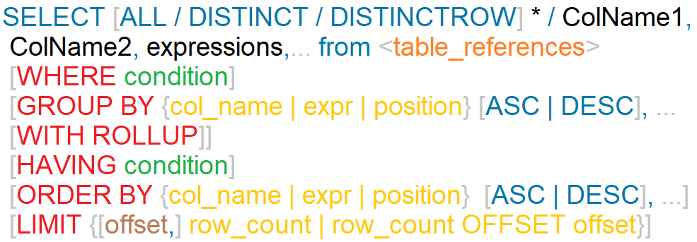
SELECT statement
SELECT syntax
DISTINCTROW is a synonym for DISTINCT.
The ALL and DISTINCT modifiers specify whether duplicate rows should be returned. ALL (the default) specifies that all matching rows should be returned, including duplicates. DISTINCT specifies removal of duplicate rows from the result set. It is an error to specify both modifiers. DISTINCTROW is a synonym for DISTINCT.

Slide 224
Nulls by default occur at the top, but you can use IsNull to assign default values, that will put it in the position you require.
The ISNULL() function tests whether an expression is NULL. If expression is a NULL value, the ISNULL() function returns 1. Otherwise, it returns 0.
ORDER BY Clause
To sort a result, use an ORDER BY clause.
You can sort on multiple columns, and you can sort different columns in different directions.
The default sort order is ascending, with smallest values first. To sort in reverse (descending) order, add the DESC keyword to the name of the column you are sorting by.
SELECT id AS 'a' FROM tbl_name ORDER BY `a`;
SELECT id AS 'a' FROM tbl_name ORDER BY 'a';

Slide 225
SELECT - ORDER BY
When doing an ORDER BY, NULL values are presented first if you do ORDER BY ... ASC and last if you do ORDER BY ... DESC.
SELECT A₁, A₂, A₃, . . . from r₁, r₂, r₃ . . .
[ORDER BY {A₁, A₂, A₃, . . . | expr | position} [ASC | DESC], ...]
"Ordered by attributes A₁, A₂, . . ."
Tuples are sorted by specified attributes
Results are sorted by A₁ first
Within each value of A₁, results are sorted by A₂
If the ASC or DESC modifier is not provided in the ORDER BY clause, the results will be sorted by expression in ASC order. This is equivalent to ORDER BY expression ASC.
The ORDER BY clause can be used in a SELECT statement, SELECT LIMIT statement, Update LIMIT, and DELETE LIMIT statement in MySQL.

Slide 226
SELECT - ORDER BY
The ORDER BY clause is used to sort the records in your result set.
SELECT A₁, A₂, A₃, . . . from r₁, r₂, r₃ . . .
[ORDER BY {A₁, A₂, A₃, . . . | expr | position} [ASC | DESC], ...]
SELECT * FROM EMP ORDER BY COMM
SELECT * FROM EMP ORDER BY COMM IS NULL
SELECT ENAME, length(ENAME) FROM EMP ORDER BY length(ENAME), ENAME desc
SELECT * FROM EMP ORDER BY IF(JOB = ‘manager', 3, IF(JOB = 'salesman', 2, null))
SELECT * FROM EMP ORDER BY FIELD(JOB, 'manager', 'salesman')
SELECT * FROM EMP ORDER BY ISNULL(COMM), COMM
SELECT ENAME `e` FROM EMP ORDER BY `e`
SELECT ENAME `e` FROM EMP ORDER BY e
SELECT ENAME 'e' FROM EMP ORDER BY 'e'

Slide 227
In WHERE clause operations can be performed using…
CONSTANTS
TABLE columns
FUNCTION calls (PRE-DEFINED / UDF)
WHERE Clause
The WHERE Clause is used when you want to retrieve specific information from a table excluding other irrelevant data.
Expressions in WHERE clause can use
Arithmetic operators
Comparison operators
Logical operators

Slide 228
SELECT - WHERE
We can use a conditional clause called WHERE clause to filter out results. Using WHERE clause, we can specify a selection criteria to select required records from a table.
SELECT A₁, A₂, A₃, . . . from r₁, r₂, r₃ . . . [ WHERE P ]
r_{i} are the relations (tables)
A_{i} are attributes (columns)
P is the selection predicate
A predicate is a condition expression that evaluates to a boolean value, either true or false.
Predicates can be used as follows: In a SELECT statement's WHERE clause or HAVING clause to determine which rows are relevant to a particular query.

Slide 229
SELECT - WHERE
We can use a conditional clause called WHERE clause to filter out results. Using WHERE clause, we can specify a selection criteria to select required records from a table.
SELECT A₁, A₂, A₃, . . . from r₁, r₂, r₃ . . . [ WHERE P ]
Comparison Functions and Operators
= | Equal operator
> | Greater than operator
>= | Greater than or equal operator
< | Less than operator
<= | Less than or equal operator
!=, <> | Not equal operator
<=> | NULL-safe equal to operator

Slide 230
SELECT - WHERE
We can use a conditional clause called WHERE clause to filter out results. Using WHERE clause, we can specify a selection criteria to select required records from a table.
SELECT A₁, A₂, A₃, . . . from r₁, r₂, r₃ . . . [ WHERE P ]
Logical Operators
AND, && | Logical AND eg. SELECT 1 AND 1;
OR, || | Logical OR eg. SELECT 1 OR 1;
NOT, ! | Negates value eg. SELECT NOT 1;
Logical AND. Evaluates to 1 if all operands are nonzero and not NULL, to 0 if one or more operands are 0, otherwise NULL is returned.
Logical OR. When both operands are non-NULL, the result is 1 if any operand is nonzero, and 0 otherwise. With a NULL operand, the result is 1 if the other operand is nonzero, and NULL otherwise. If both operands are NULL, the result is NULL.
Logical NOT. Evaluates to 1 if the operand is 0, to 0 if the operand is nonzero, and NOT NULL returns NULL.

Slide 231
SELECT - WHERE
We can use a conditional clause called WHERE clause to filter out results. Using WHERE clause, we can specify a selection criteria to select required records from a table.
SELECT A₁, A₂, A₃, . . . from r₁, r₂, r₃ . . . [ WHERE P ]
Comparison Functions and Operators
IS NULL | NULL value test
IS NOT NULL | NOT NULL value test
ISNULL(expr) | If expr is NULL, ISNULL() returns 1, otherwise it returns 0.
STRCMP(expr1,expr2) | STRCMP() returns 0 if the strings are the same, -1 if the first argument is smaller than the second according to the current sort order, and 1 otherwise.
LEAST(value1,value2,...) | With two or more arguments, returns the smallest argument.
GREATEST(value1,value2,...) | With two or more arguments, returns the largest argument.
SELECT GREATEST(10, 20, 30), -- 30
LEAST(10, 20, 30); -- 10
SELECT GREATEST(10, null, 30), -- null
LEAST(10, null , 30); -- null

Slide 232
SELECT - WHERE
We can use a conditional clause called WHERE clause to filter out results. Using WHERE clause, we can specify a selection criteria to select required records from a table.
SELECT A₁, A₂, A₃, . . . from r₁, r₂, r₃ . . . [ WHERE P ]
Comparison Functions and Operators
BETWEEN ... AND ... | Check whether a value is within a range of values
NOT BETWEEN ... AND ... | Check whether a value is not within a range of values
expr IN (value,...) | Check whether a value is within a set of values
expr NOT IN (value,...) | Check whether a value is not within a set of values
expr LIKE pat [ESCAPE 'escape_char'] | Pattern matching using an SQL pattern. Returns 1 (TRUE) or 0 (FALSE). If either expr or pat is NULL, the result is NULL.
expr NOT LIKE pat [ESCAPE 'escape_char'] | Negation of simple pattern matching.

Slide 233
SELECT - WHERE
We can use a conditional clause called WHERE clause to filter out results. Using WHERE clause, we can specify a selection criteria to select required records from a table.
SELECT A₁, A₂, A₃, . . . from r₁, r₂, r₃ . . . [ WHERE P ]
Group Operators
(expr, [expr]…)
ROW(expr, [expr]…)
Note: Both the statements are same.
SELECT * FROM EMP WHERE (DEPTNO, PWD) = (SELECT DEPTNO, PWD FROM DEPT WHERE DEPTNO = 30);
SELECT * FROM EMP WHERE ROW (DEPTNO, PWD) = (SELECT DEPTNO, PWD FROM DEPT WHERE DEPTNO = 30);

Slide 234
SELECT - WHERE
We can use a conditional clause called WHERE clause to filter out results. Using WHERE clause, we can specify a selection criteria to select required records from a table.
SELECT A₁, A₂, A₃, . . . from r₁, r₂, r₃ . . . [ WHERE P ]
Comparison Functions and Operators
COALESCE(value,...) | Returns the first non-NULL value in the list, or NULL if there are no non-NULL values.
INTERVAL(N,N1,N2,N3,...) | Returns 0 if N < N1, 1 if N < N2 and so on or -1 if N is NULL. All arguments are treated as integers. It is required that N1 < N2 < N3 < ... < Nn for this function to work correctly.
SELECT * FROM EMP WHERE JOB = 'MANAGER' UNION SELECT * FROM EMP WHERE JOB = 'SALESMAN'

Slide 235
IS NULL / IS NOT NULL
"IS NULL" is the keyword that performs the Boolean comparison. It returns true if the supplied value is NULL and false if the supplied value is not NULL.
“IS NOT NULL" is the keyword that performs the Boolean comparison. It returns true if the supplied value is not NULL and false if the supplied value is null.

Slide 236




NULL- IS NULL / IS NOT NULL

Slide 237
SELECT * from EMP where ename = 'smith' or True;
SELECT * from EMP where ename in ('smith', True);
Like

Slide 238


Like - String Comparison Functions
syntax
expr LIKE pat [ESCAPE 'escape_char']
% matches any number of characters, even zero characters.
_ matches exactly one character.
If we use default escape character '\', then don’t use ESCAPE keyword.
To test for literal instances of a wildcard character, precede it by the escape character. If you do not specify the ESCAPE character, \ is assumed.
\% matches one % character.
\_ matches one _ character.
The ESCAPE keyword is used to escape pattern matching characters such as the (%) percentage and underscore (_) if they form part of the data.

Slide 239
SELECT … expressions

Slide 240
SELECT - expressions
SELECT syntax
SELECT expressions,... from <table_references>
SELECT ename, ename = ename from EMP;
SELECT ename, ename = 'smith' from EMP;

Slide 241

Standard SQL does not allow you to use an alias in the GROUP BY clause, however, MySQL supports this.
MySQL also allows you to sort the groups in ascending or descending orders while the standard SQL does not.
DISTINCT (if used outside an aggregation function) that is superfluous.
GROUP BY Clause
SELECT id AS 'a', COUNT(*) AS cnt FROM tbl_name GROUP BY `a`;
SELECT id AS 'a', COUNT(*) AS cnt FROM tbl_name GROUP BY 'a';

Slide 242
Standard SQL does not allow you to use an alias in the GROUP BY clause, however, MySQL supports this.
MySQL also allows you to sort the groups in ascending or descending orders while the standard SQL does not.
G_{1,}G_{2,….,}G_{n,} F₁(A₁), F₂(A₂),…..F_{n}(A_{n}) ^{(r)}
GROUP BY Clause with DISTINCT
DISTINCT (if used outside an aggregation function) that is superfluous.

Slide 243
SELECT - GROUP BY
Columns selected for output can be referred to in ORDER BY and GROUP BY clauses using column names, column aliases, or column positions. Column positions are integers and begin with 1
If you use GROUP BY, output rows are sorted according to the GROUP BY columns as if you had an ORDER BY for the same columns. To avoid the overhead of sorting that GROUP BY produces, add ORDER BY NULL.
MySQL extends the GROUP BY clause so that you can also specify ASC and DESC after columns named in the clause
If a query includes GROUP BY but you want to avoid the overhead of sorting the result, you can suppress sorting by specifying ORDER BY NULL.
For example:
SELECT JOB, COUNT(*) FROM EMP GROUP BY JOB ORDER BY NULL;
SELECT * FROM EMP ORDER BY FIELD (JOB, 'MANAGER', 'SALESMAN');

Slide 244
SELECT - GROUP BY
This function's will produce a single value for an entire group or a table.
You can use GROUP BY to group values from a column, and, if you wish, perform calculations on that column.
SELECT G₁, G₂, . . . , F₁(A₁), F₂(A₂), . . . from r₁, r₂, r₃ . . .
[GROUP BY {G₁, G₂, . . . | expr | position} [ASC | DESC], ... [WITH ROLLUP]]
SELECT JOB , SUM(SAL) FROM EMP GROUP BY JOB WITH ROLLUP;
SELECT COALESCE (JOB, 'Total') , SUM(SAL) FROM EMP GROUP BY JOB WITH ROLLUP;
Aggregate (GROUP BY) Function
AVG([DISTINCT] expr) | Returns the average value of expr. The DISTINCT option can be used to return the average of the distinct values of expr.
COUNT(expr) | Returns a count of the number of non-NULL values of expr in the rows retrieved by a SELECT statement. If there are no matching rows, COUNT() returns 0.
COUNT(DISTINCT expr,[expr...]) | Returns a count of the number of rows with different non-NULL expr values. If there are no matching rows, COUNT(DISTINCT) returns 0.

Slide 245







The aggregate functions allow you to perform the calculation of a set of rows and return a single value. The GROUP BY clause is often used with an aggregate function (such as SUM, AVG, MAX, MIN, and COUNT.) to perform calculation and return a single value for each subgroup.
The HAVING clause can refer to aggregate functions, which the WHERE clause cannot.
aggregate functions
// ERROR

Slide 246


The aggregate functions allow you to perform the calculation of a set of rows and return a single value. The GROUP BY clause is often used with an aggregate function (such as SUM, AVG, MAX, MIN, and COUNT.) to perform calculation and return a single value for each subgroup.
The HAVING clause can refer to aggregate functions, which the WHERE clause cannot.
aggregate functions

Slide 247

There are 3 places where aggregate functions can appear in a query
in the SELECT-LIST (the items before the FROM clause).
in the ORDER BY clause.
and in the HAVING clause.
"An aggregate may NOT appear in the WHERE clause unless it is in a subquery contained in a WHERE or HAVING clause or a select list, and the column being aggregated is an outer reference"

Slide 248
AVG and COUNT Aggregate (GROUP BY) Function
Blank space between aggregate functions like (SUM, MIN, MAX, COUNT) are not allowed. Eg. SELECT SUM (sal) from EMP;
AVG()
If there are no matching rows, AVG() returns NULL.
SUM()
If the return set has no rows, SUM() returns NULL.
The DISTINCT keyword can be used to sum only the distinct values of expr.
COUNT()
Returns a count of the number of non-NULL values.
If there are no matching rows, COUNT() returns 0.
COUNT(*) is somewhat different in that it returns a count of the number of rows retrieved, whether or not they contain NULL values.

Slide 249
AVG and COUNT Aggregate (GROUP BY) Function
Blank space between aggregate functions like (SUM, MIN, MAX, COUNT) are not allowed. Eg. SELECT SUM (sal) from EMP;
SELECT COUNT(JOB) FROM EMP;
SELECT COUNT(*) FROM EMP;
SELECT COUNT(EMP.*) FROM EMP;
SELECT COUNT(IF(COMM IS NULL, 1, NULL)), COUNT(IF(COMM IS NOT NULL, 0, NULL)) FROM EMP;
SET sql_mode = ' ';
SET sql_mode = IGNORE_SPACE;

Slide 250
SELECT - GROUP BY
This function's will produce a single value for an entire group or a table.
You can use GROUP BY to group values from a column, and, if you wish, perform calculations on that column.
SELECT G₁, G₂, . . . , F₁(A₁), F₂(A₂), . . . from r₁, r₂, r₃ . . .
[GROUP BY {G₁, G₂, . . . | expr | position} [ASC | DESC], ... [WITH ROLLUP]]
Aggregate (GROUP BY) Function
MAX([DISTINCT] expr) | Returns the maximum value of expr. MAX() may take a string argument; in such cases, it returns the maximum string value. The DISTINCT keyword can be used to find the maximum of the distinct values of expr.
MIN([DISTINCT] expr) | Returns the minimum value of expr. MIN() may take a string argument; in such cases, it returns the minimum string value. The DISTINCT keyword can be used to find the minimum of the distinct values of expr.
SUM([DISTINCT] expr) | Returns the sum of expr. If the return set has no rows, SUM() returns NULL. The DISTINCT keyword can be used to sum only the distinct values of expr.

Slide 251
MIN and MAX Aggregate (GROUP BY) Function
Blank space between aggregate functions like (SUM, MIN, MAX, COUNT) are not allowed. Eg. SELECT SUM (sal) from EMP;
MAX()
If there are no matching rows, MAX() returns NULL.
MAX() may take a string argument; in such cases, it returns the maximum string value
MAX() compares ENUM and SET columns by their string value rather than by the string's relative position in the set.
MIN()
If there are no matching rows, MIN() returns NULL.
MIN() may take a string argument; in such cases, it returns the minimum string value.
MIN() compares ENUM and SET columns by their string value rather than by the string's relative position in the set.

Slide 252
SELECT - GROUP BY
This function's will produce a single value for an entire group or a table.
You can use GROUP BY to group values from a column, and, if you wish, perform calculations on that column.
SELECT G₁, G₂, . . . , F₁(A₁), F₂(A₂), . . . from r₁, r₂, r₃ . . .
[GROUP BY {G₁, G₂, . . . | expr | position} [ASC | DESC], ... [WITH ROLLUP]]
Aggregate (GROUP BY) Function
GROUP_CONCAT([DISTINCT] expr [,expr ...] [ORDER BY {col_name | expr} [ASC | DESC] [,col_name ...]] [SEPARATOR str_val]) | This function returns a string result with the concatenated non-NULL values from a group. It returns NULL if there are no non-NULL values. e.g. SELECT job, group_concat(deptno order by deptno) from EMP group by job; SELECT job, group_concat(sal order by sal separator ' ! ') from EMP group by job;

Slide 253
There are 3 places where aggregate functions can appear in a query
in the SELECT-LIST (the items before the FROM clause).
in the ORDER BY clause.
and in the HAVING clause.
"An aggregate may NOT appear in the WHERE clause unless it is in a subquery contained in a WHERE or HAVING clause or a select list, and the column being aggregated is an outer reference"

Slide 254
SELECT - GROUP BY
Examples:
SELECT JOB, SAL + 1001 FROM EMP GROUP BY JOB;
SELECT JOB, COUNT(JOB) FROM EMP GROUP BY COUNT(JOB); //error
SELECT JOB, SAL + 1001 FROM EMP GROUP BY SAL + 1001;
SELECT ENAME, LENGTH(ENAME) R1 FROM EMP GROUP BY R1;
SET sql_mode = '';
SET sql_mode = 'ONLY_FULL_GROUP_BY';

Slide 255
SELECT …. For UPDATE

Slide 256
SELECT - for UPDATE
SELECT * FROM EMP for UPDATE;

Slide 257
The HAVING clause is often used with the GROUP BY clause to filter groups based on a specified condition. If the GROUP BY clause is omitted, the HAVING clause behaves like the WHERE clause.
The HAVING clause can refer to aggregate functions, which the WHERE clause cannot.
HAVING Clause
If the GROUP BY clause is omitted, the HAVING clause behaves like the WHERE clasue.

Slide 258
SELECT - HAVING
The MySQL HAVING clause is used in the SELECT statement to specify filter conditions for a group of rows. HAVING clause is often used with the GROUP BY clause. When using with the GROUP BY clause, we can apply a filter condition to the columns that appear in the GROUP BY clause.
If the GROUP BY clause is omitted, the HAVING clause behaves like the WHERE clause.
SELECT G₁, G₂, . . . , F₁(A₁), F₂(A₂), . . . from r₁, r₂, r₃ . . .
[GROUP BY {G₁, G₂, . . . | expr | position} [ASC | DESC], ... [WITH ROLLUP]]
[ HAVING having_condition ]

Slide 259
When WHERE and HAVING clause are used together in a SELECT query with aggregate function, WHERE clause is applied first on individual rows and only rows which pass the condition is included for creating groups. Once group is created, HAVING clause is used to filter groups based upon condition specified.
Difference between WHERE and HAVING clause

Slide 260
WHERE and HAVING clause
WHERE clause can be used with - SELECT, UPDATE, and DELETE statements, where as HAVING clause can only be used with the SELECT statement.
WHERE clause filters rows before aggregation (GROUPING), where as, HAVING clause filters groups, after the aggregations are performed.
Aggregate functions (SUM , MIN, MAX, AVG and COUNT) cannot be used in the WHERE clause condition, unless it is in a subquery contained in a HAVING clause, whereas, aggregate functions can be used in HAVING clause.
The Where clause acts as a pre filter where as Having clause acts as a post filter.

Slide 261
Row Limiting Clause
LIMIT is applied after HAVING
LIMIT also enables you to pull a section of rows from the middle of a result set. Specify two values: The number of rows to skip at the beginning of the result set, and the number of rows to return.

Slide 262
SELECT - LIMIT
Limit value are not to be given within ()
The LIMIT clause can be used to constrain the number of rows returned by the SELECT statement. LIMIT takes one or two numeric arguments, which must both be nonnegative integer value.
SELECT column-list from <table_references>
[LIMIT {[offset,] row_count | row_count OFFSET offset}]
You can specify an offset using OFFSET from where SELECT will start returning records. By default offset is zero.
The first argument specifies the offset of the first row to return, and the second specifies the maximum number of rows to return.
SELECT * FROM EMP LIMIT 5;
SELECT * FROM EMP LIMIT 1, 5;
SELECT * FROM EMP LIMIT 5 offset 1;
SELECT rand(), EMP.* FROM EMP ORDER BY 1 LIMIT 1;

Slide 263
SELECT - LIMIT
This variable is used to return the maximum number of rows from SELECT statements. Its default value is unlimited. But if you changed the limit then SELECT statement returns the rows equals to the value.
SQL_SELECT_LIMIT = {value | DEFAULT}
This variable does not apply to SELECT statement that executed in the stored procedures or functions.
SET SQL_SELECT_LIMIT=2;
SET SQL_SELECT_LIMIT=DEFAULT;
SELECT * FROM EMP;

Slide 264
window function

Slide 265
window function
TODO
RANK() OVER([PARTITION BY expr [, expr] ... ORDER BY expr [ASC | DESC] [, expr [ASC | DESC]] ...])
DENSE_RANK() OVER([PARTITION BY expr [, expr] ... ORDER BY expr [ASC|DESC] [, expr [ASC | DESC]] ...])
ROW_NUMBER() OVER([PARTITION BY expr [, expr] ... ORDER BY expr [ASC|DESC] [, expr [ASC | DESC]] ...])

Slide 266
User-Defined Variables

Slide 267
User-Defined Variables
A user variable name can contain other characters if you quote it as a string or identifier (for example, @'my-var', @"my-var", or @`my-var`).
User-defined variables are session specific. A user variable defined by one client cannot be seen or used by other clients.
All variables for a given client session are automatically freed when that client exits.
User variable names are not case sensitive. Names have a maximum length of 64 characters.
If the value of a user variable is selected in a result set, it is returned to the client as a string.
If you refer to a variable that has not been initialized, it has a value of NULL and a type of string.

Slide 268
User-Defined Variables
You can store a value in a user-defined variable in one statement and refer to it later in another statement. This enables you to pass values from one statement to another.
SET @var_name = expr [, @var_name = expr] ...
For SET, either = or := can be used as the assignment operator.
You can also assign a value to a user variable in statements (SELECT, …) other than SET. In this case, the assignment operator must be := and not = because latter is treated as the comparison operator =.
mysql> SET @v1 = 1001, @v2 = 2, @v3 = 'Saleel';
mysql> SET @v1 = 1001, @v2 = 2, @v3 := @v1 + @v2;
mysql> SELECT @v1 := MIN(SAL), @v2 := MAX(SAL) FROM EMP;
mysql> SELECT @v1, @v2, @v3;

Slide 269
User-Defined Variables
User variables are intended to provide data values. They cannot be used directly in an SQL statement as an identifier or as part of an identifier.
SET @var_name = expr [, @var_name = expr] ...
mysql> SET @v1 = 'ENAME'; // ENAME IS COLUMN NAME.
mysql> SELECT @v1 FROM EMP;

Slide 270
Rownum
mysql> SELECT * FROM (SELECT @cnt := @cnt + 1 R1, EMP.* FROM EMP, (SELECT @cnt := 0) T1) T2 WHERE R1 > @cnt - 7;

Slide 271
Select - Rownum
mysql> SET @ROW = 0;
mysql> SELECT @ROW := @ROW + 1 AS ROWNUM , EMP.* FROM EMP;
mysql> SELECT @ROW := @ROW + 1 AS ROWNUM , EMP.* FROM EMP,
(SELECT @ROW := 0) AS E;
mysql> SELECT @rank := @rank + 1 ,E.* FROM (SELECT JOB, SAL FROM EMP
GROUP BY JOB ORDER BY SAL desc) E , (SELECT @rank := 0) EE;

Slide 272
Questions?

Slide 273
Prepared SQL Statement

Slide 274
Prepared SQL Statement
The PREPARE statement prepares a SQL statement and assigns it a name, stmt_name. The prepared statement is executed with EXECUTE and released with DEALLOCATE PREPARE.
PREPARE stmt_name FROM preparable_stmt
EXECUTE stmt_name
[USING @var_name [, @var_name] ...]
{DEALLOCATE | DROP} PREPARE stmt_name

Slide 275
Prepared SQL Statement
Example of prepared statement
PREPARE stat1 from 'SELECT * from EMP';
EXECUTE stat1;
SET @x := 'SELECT * from EMP where deptno = 10';
PREPARE stat1 from @x;
EXECUTE stat1;
SET @x:=10;
PREPARE stat1 from 'SELECT * from EMP where deptno = ?';
EXECUTE stat1 using @x;
SET @x:=10, @y := 3000;
PREPARE stat1 from 'SELECT * from EMP where deptno = ? and sal >= ?';
EXECUTE stat1 using @x, @y;
DEALLOCATE PREPARE stat1;

Slide 276
SELECT ... INTO

Slide 277
Select … INTO
The SELECT ... INTO form of SELECT enables a query result to be stored in variables or written to a file.
An INTO clause should not be used in a nested SELECT because such a SELECT must return its result to the outer context.
SELECT ... INTO var_list
SELECT ... INTO OUTFILE
SELECT ... INTO DUMPFILE
Selects column values and stores them into variables.
Writes the selected rows to a file. Column and line terminators can be specified to produce a specific output format.
Writes a single row to a file without any formatting.

Slide 278
SELECT ... INTO var_list

Slide 279
Select … INTO var_list
The SELECT ... INTO form of SELECT enables a query result to be stored in variables or written to a file.
SELECT ... INTO var_list
The selected values are assigned to the variables.
The number of variables must match the number of columns.
The query should return a single row.
If the query returns no rows, a warning with error code 1329 occurs (No data), and the variable values remain unchanged.
If the query returns multiple rows, error 1172 occurs (Result consisted of more than one row).
The statement may retrieve multiple rows, you can use LIMIT 1 to limit the result set to a single row.

Slide 280
Select … INTO var_list
The SELECT ... INTO form of SELECT enables a query result to be stored in variables or written to a file.
SELECT ... INTO var_list
SET @x = 0;
SET @y = null;
SELECT empno, ename into @x, @y from EMP where empno=7788;
SET @x = 0;
SET @y = null;
SELECT max(sal), min(sal) into @x, @y from EMP where empno=7788;

Slide 281
If not working then do changes in my.ini file.
secure_file_priv = ""
SHOW VARIABLES LIKE "secure_file_priv";
SELECT ... INTO OUTFILE

Slide 282
Select … INTO OUTFILE
Writes the selected rows to a file. Column and line terminators can be specified to produce a specific output format.
SELECT ... INTO OUTFILE
SELECT * from EMP INTO OUTFILE "d:/Test/o.txt";
SELECT * from EMP INTO OUTFILE "d:/Test/o.txt" fields terminated by ',';
SELECT * from EMP INTO OUTFILE "d:/Test/o.txt" fields terminated by ',' lines terminated by '\n';
SELECT * from EMP INTO OUTFILE "d:/Test/o.txt" fields terminated by ',' optionally enclosed by '"' lines terminated by '\n';

Slide 283
SELECT ... INTO DUMPFILE

Slide 284
Select … INTO DUMPFILE
If you use INTO DUMPFILE instead of INTO OUTFILE, MySQL writes only one row into the file, without any column or line termination and without performing any escape processing. This is useful if you want to store a BLOB value in a file.
SELECT ... INTO DUMPFILE
SELECT * from EMP where empno = 7788 INTO DUMPFILE "d:/Test/o.txt";

Slide 285
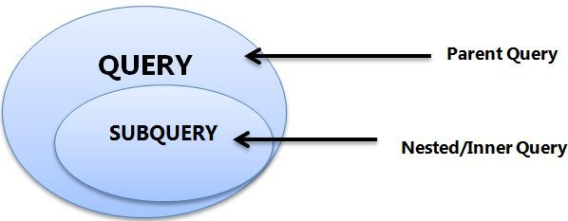
- A subquery must be enclosed in parentheses.
- Use single-row operators with single-row subqueries, and use multiple-row operators with multiple-row subqueries.
- If a subquery (inner query) returns a null value to the outer query, the outer query will not return any rows when using certain comparison operators in a WHERE clause.
Sub-Queries
You may use comparison operators such as <>, <, >, <=, and >= with a single row subquery.
Multiple row subquery returns one or more rows to the outer SQL statement. You may use the IN, ANY, or ALL operator in outer query to handle a subquery that returns multiple rows.

Slide 286
If ORDER BY occurs within a subquery and also is applied in the outer query, the outermost ORDER BY takes precedence.
(SELECT ... ORDER BY a) ORDER BY a DESC;
If LIMIT occurs within a subquery and also is applied in the outer query, the outermost LIMIT takes precedence.
(SELECT ... LIMIT 1) LIMIT 2;
Sub-Queries

Slide 287

Single Row Subqueries
A single row subquery returns zero or one row to the outer SQL statement. You can place a subquery in a WHERE clause, a HAVING clause, or a FROM clause of a SELECT statement.
Outer Query
Subquery or Inner query

Slide 288

Multiple Row and Column Subqueries
A multiple row subquery returns one or more rows to the outer SQL statement. You may use the IN, ANY, or ALL operator in outer query to handle a subquery that returns multiple rows.
Outer Query
Subquery or Inner query

Slide 289
Subqueries
A subquery is a SELECT statement within another statement.
A subquery may occur in:
A SELECT clause
A FROM clause
A WHERE clause
A HAVING clause
A subquery's outer statement can be any one of: SELECT, INSERT, UPDATE, DELETE, SET, or DO.

Slide 290

Subqueries with INSERT
syntax
INSERT INTO table_name [ (column1 [, column2 ]) ]
SELECT [ *|column1 [, column2 ] FROM table1 [, table2 ]
[ WHERE VALUE OPERATOR ];

Slide 291
Subqueries with UPDATE
syntax
UPDATE table_name SET column_name = new_value [ WHERE OPERATOR [ VALUE ] (SELECT column_name FROM table_name) [ WHERE) ]

Slide 292
Subqueries with DELETE
syntax
DELETE FROM table_name [ WHERE OPERATOR [ VALUE ]
(SELECT column_name FROM table_name) [ WHERE) ]

Slide 293
Types of Subqueries
The Subquery as Scalar Operand – SELECT clause (to give in selection-list)
Comparisons using Subqueries – Single row subquery (to give in WHERE or in HAVING clause)
Subqueries in the FROM Clause – Inline Views (to give in FROM clause)
Subqueries with ALL, ANY, IN, or SOME – Multiple row subquery (to give in WHERE clause or HAVING clause)
Row Subqueries
Subqueries with EXISTS or NOT EXISTS
Correlated Subqueries

Slide 294
The Subquery as Scalar Operand

Slide 295
The Subquery as Scalar Operand
A scalar subquery is a subquery that returns exactly one column value from one row. A scalar subquery is a simple operand, and you can use it almost anywhere a single column value is legal.
If the subquery returns 0 rows then the value of scalar subquery expression is NULL.
if the subquery returns more than one row then MySQL returns an ERROR.
SELECT (SELECT 1, 2) ; // error
SELECT (SELECT ename, sal FROM EMP); // error
SELECT (SELECT * FROM EMP); // error
SELECT (SELECT NULL + 1);
SELECT ENAME, (SELECT DNAME FROM DEPT WHERE EMP.DEPTNO = DEPT.DEPTNO) R1 FROM EMP ;

Slide 296


The Subquery as Scalar Operand
SELECT (SELECT STDPRICE FROM PRICE WHERE PRODID = 100890 AND ENDDATE IS NOT NULL) "STANDARD PRICE", (SELECT MINPRICE FROM PRICE WHERE PRODID = 100890 AND ENDDATE IS NOT NULL) AS "MINIMUM PRICE";
SELECT (SELECT STDPRICE FROM PRICE WHERE PRODID = 100890 AND ENDDATE IS NOT NULL) - (SELECT MINPRICE FROM PRICE WHERE PRODID = 100890 AND ENDDATE IS NOT NULL) AS "PRICE DIFFERENCE";

